Slide 1
Research Gaps
Lead: Blue-Action
Steffen M. Olsen (DMI)

Slide 2




Thematic blocks
Horizon Europe Pillar 2 Clusters
AMOC and Ocean Observations
Gerard McCarthy
Maynooth Univ.
AMOC fingerprints
Observing the AMOC
Beyond the AMOC
Arctic Weather and Climate
Steffen M. Olsen
DMI
Arctic weather systems and their extremes
Arctic (Polar) warming
Predictability and Model Uncertainty
Safe Operations in the Arctic
Scalability of
Climate Services
Mark Payne
DTU-Aqua
Scalability of fish forecasts
Joan Ballester
ISGlobal
Human Health
Human health and adaptation
Research & indigenous communities

Slide 3

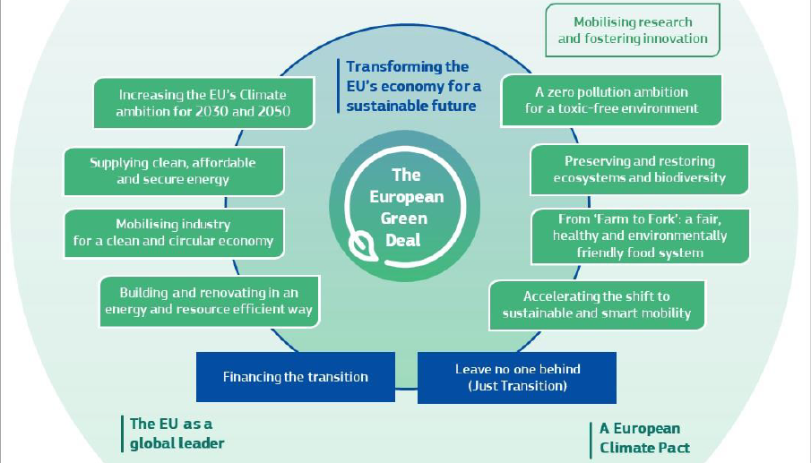
Thematic blocks
Green Deal contributions

Slide 4
AMOC
Lead: Blue-Action
Presenter: Gerard McCarthy (Maynooth Univ.)

Slide 5
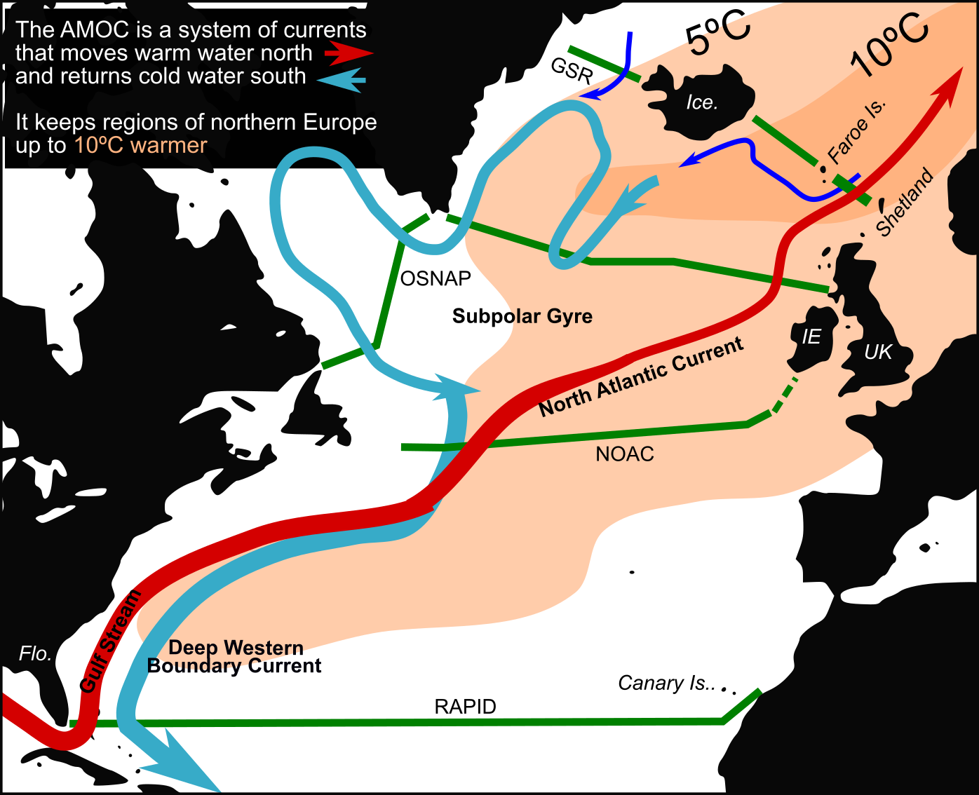
AMOC observing systems (green) cover an observational gap and chart the vital signs of this complex set of ocean currents and provide emerging constraints for Earth System Models.
Emerging technology and sensors are changing how Blue-Action scientists make these measurements, leading to optimization of long-term funded infrastructure.
Notes:
A 5ºC change would transform the climate of Dublin to the climate of Rejkavik.

Slide 6
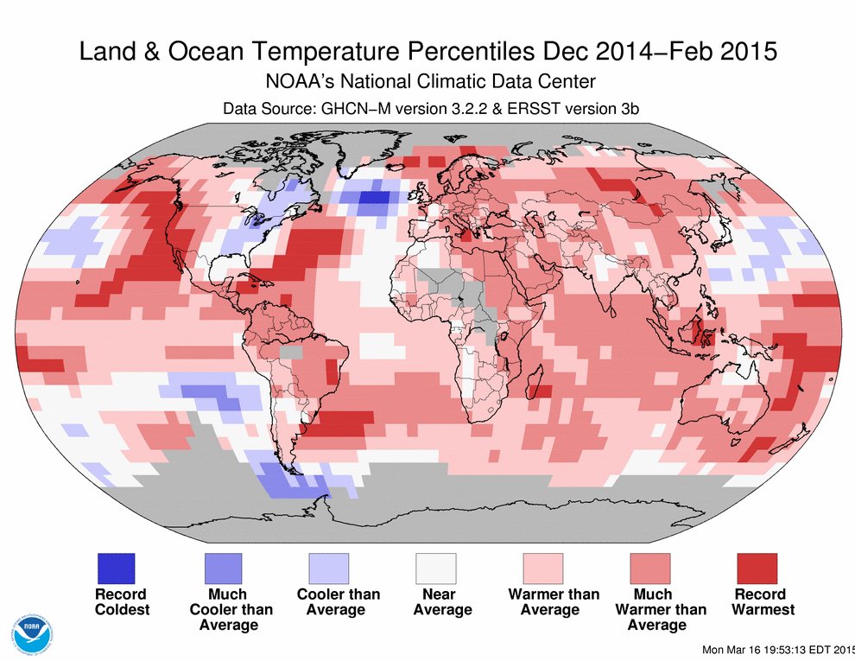
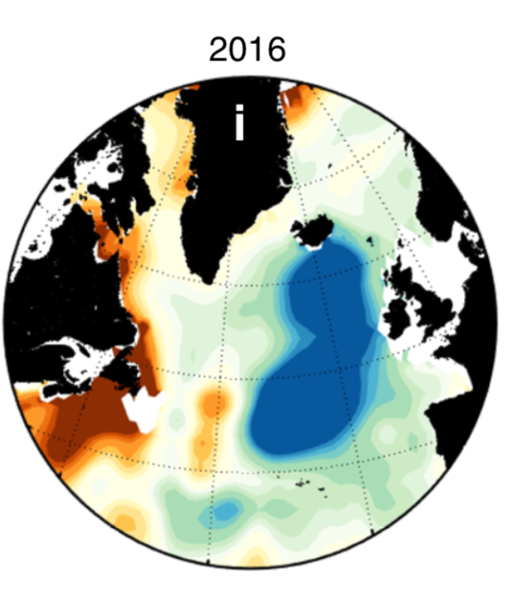
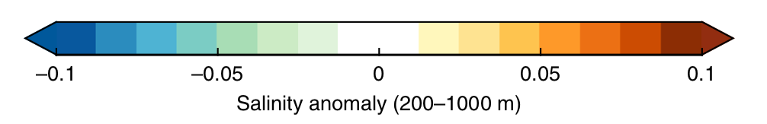
Record Cold Anomaly in 2015
Freshest in 120 years, 2016
from Holliday et al., 2020
Unprecedented changes are ongoing in the Atlantic.
We know the AMOC has weakened. Could we be approaching a tipping point?
An abrupt AMOC collapse would be an environmental disaster for Europe.

Slide 7
Arctic Weather and Climate
Lead: Blue-Action
Presenter: Steffen M. Olsen (DMI)

Slide 8
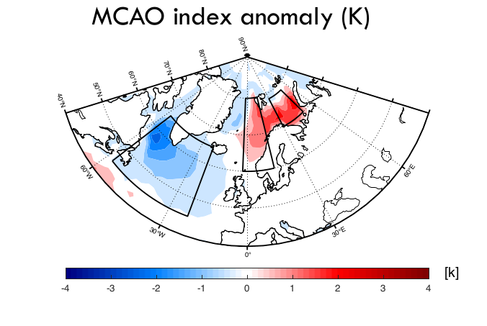
Arctic weather systems and their extremes
Probabilistic predictions of extremes weather in seasonal prediction systems have been advanced through a process‐oriented diagnosis of weather systems in which extremes are likely to form.
Established relationships (empirical) between large scale atmospheric and lower boundary drivers include blocking, jet stream position, eddy heat transport and stratosphere-troposphere interactions.
For example, sudden stratospheric warming events can regionally be used to predict a 33% increase in the frequency of potentially hazardous cold air outbreaks and associated development of intense cyclone activity such as polar lows. The critical stratospheric winds can be predicted two months ahead.
The potential to further increase the statistical-dynamical seasonal to long range forecast skill is significant. Research is needed to link non-identified modes of atmospheric variability and systems not related to modes of variability to extremes, as well as the role of troposphere-stratosphere interactions.

Slide 9
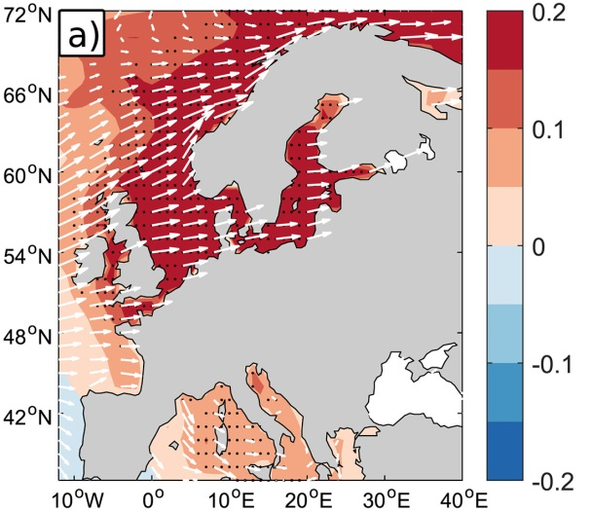
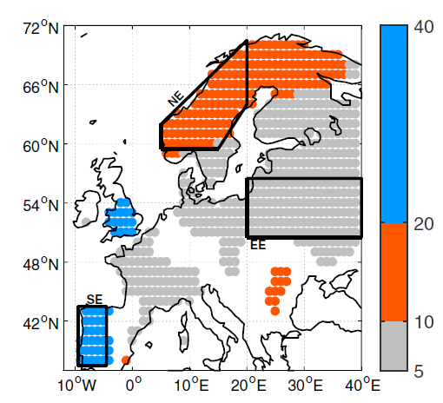
Predictability and model uncertainty
Climate prediction in the Atlantic and Arctic sector is reaching useful skill levels. H2020 and European collaboration has been instrumental.
Still,
Climate variability in the North Atlantic Sector, appears to be more predictable than models imply.
Ocean predictability does not translate into atmospheric predictability over land in our systems.
We need to understand why!
Årthun et al. 2018
Ocean temperatures and winds impacting European climate
Dominant time scales of Surface air Temperature (yrs)
Notes:
Temperature anomalies in the North Atlantic Ocean are advected over land by the mean westerly winds and provide a mechanism through which ocean temperature controls the variability and provides predictability
We are still outperformed by statistical/empirical forecasts

Slide 10
Predictability and model uncertainty
Improving prediction skill requires understanding of key limiting processes and development of new, better resolved (processes) Earth System Models.
Massive investments are required to develop these new models, as developments in computing infrastructure now outpace development of numerical climate models.
To cope with these new challenges the climate researchers need to adopt community models, developed by large-teams, with simulations analysed by the wider scientific community
Supporting research is required into areas of optimal ensemble predictions and assimilation methods across time-scales.
Sustained long-term observations (ocean), new process oriented and ‘supersite’ observations are critical for the development of validating the new models.
Climate modellers need to provide feedback to the observational community on required data, through workshops and by working together in projects

Slide 11
Fishforecasts – Climate Services to improve fisheries management and sustainability
Lead: Blue-Action
Mark R. Payne (Technical University of Denmark)

Slide 12
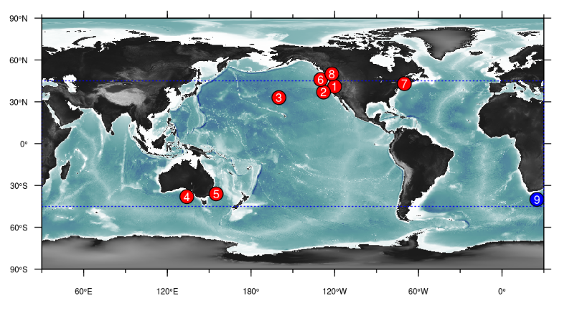
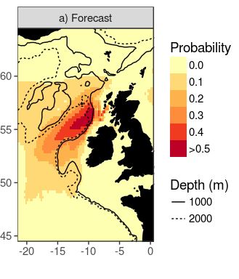
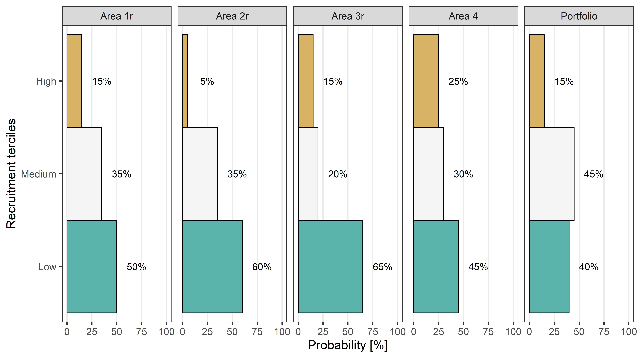
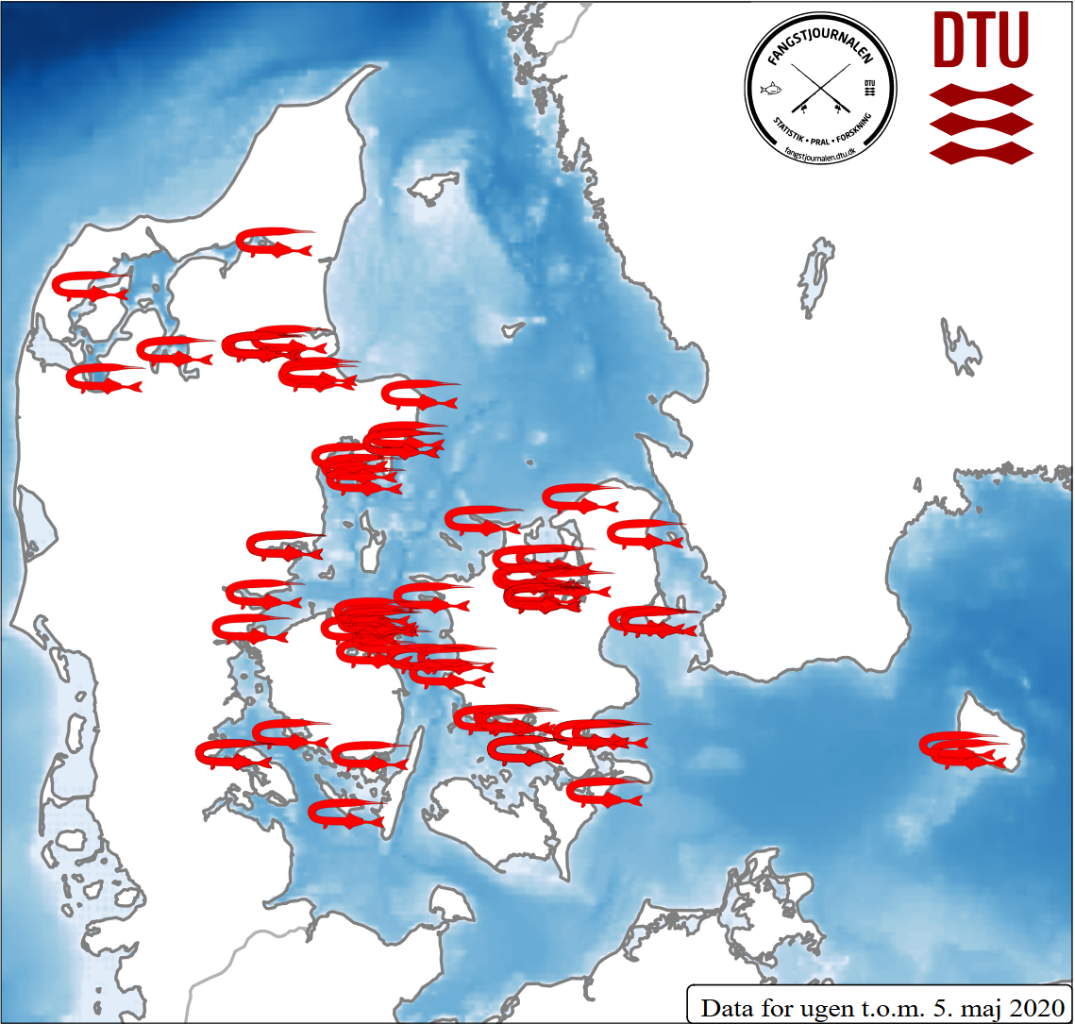
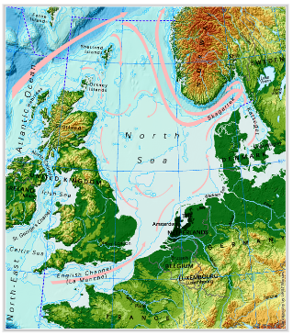



Fishforecasts
Climate Services for Marine Fisheries
2017
No Forecast Products in Europe
2020
First European Forecasts
Transferability
Application in ocean
dependent nations
Sustainable development
Climate adaptation planning
e.g. via UN Ocean Decade
Exploitation
Incorporation into
management
Proving added value
Upscaling
More species
Coastal areas
More responses

Slide 13
Health
Lead: Blue-Action
Joan Ballester (ISGlobal)

Slide 14
Predictability of Climate Impacts on Health
Which climate impacts on health are predictable?
Which are the sources and lead times of predictability?
Y = Risk of Death
X = Temperature
Y = Error in Mortality Prediction
X = Lead Time
Work in Progress in Blue-Action
Notes:
Although new sources of predictability are continuously explored, the skill and limits in current predictability are well established.
We can use epidemiological models to transform this climate variability and predictability into climate impacts on health.
But we do not know yet which of these climate impacts are predictable, and which are the sources and lead times of their predictability.
In Blue-Action, we are exploring the predictability of the Mortality that is Attributable to Ambient Temperatures.

Slide 15
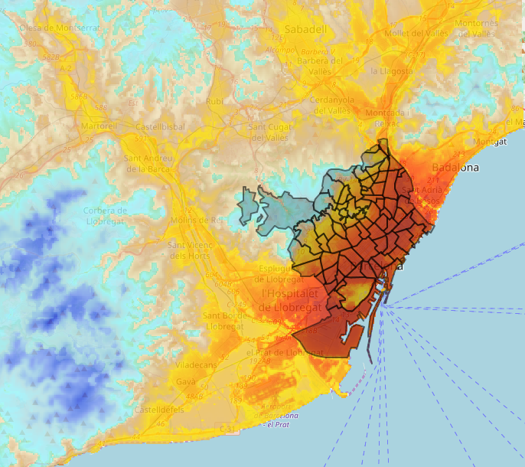
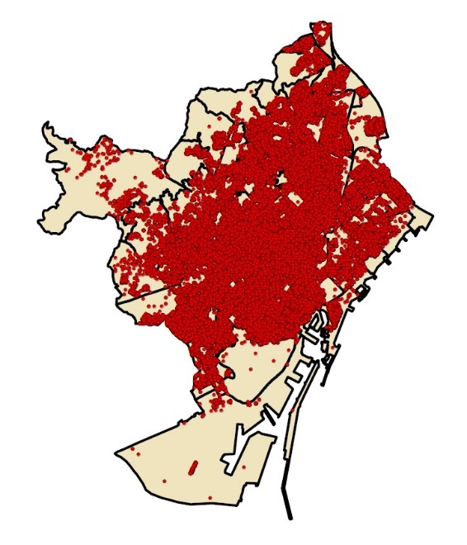
How Local and Far in Time Can We Go?
There is a boom in climate services for health.
Climate forecasts and predictions are used with no assessment of their skill.
Gap: Spatiotemporal scales of health predictability.
+
=
High-Res. Temperature
from Urban Climate Models
Deaths
from Individual Records
Risk of Death
from Epidemiological Models
Notes:
We are experiencing a boom in climate services for health.
A few interesting examples are based on weather and seasonal forecasting, such as vector-borne diseases.
But the vast majority are driven by climate change projections, and they go from global to local scales.
They generally do not explore the underlying sources of weather and climate predictability.
It is urgent to characterise the limits in the spatial and temporal scales of health predictability.

Slide 16




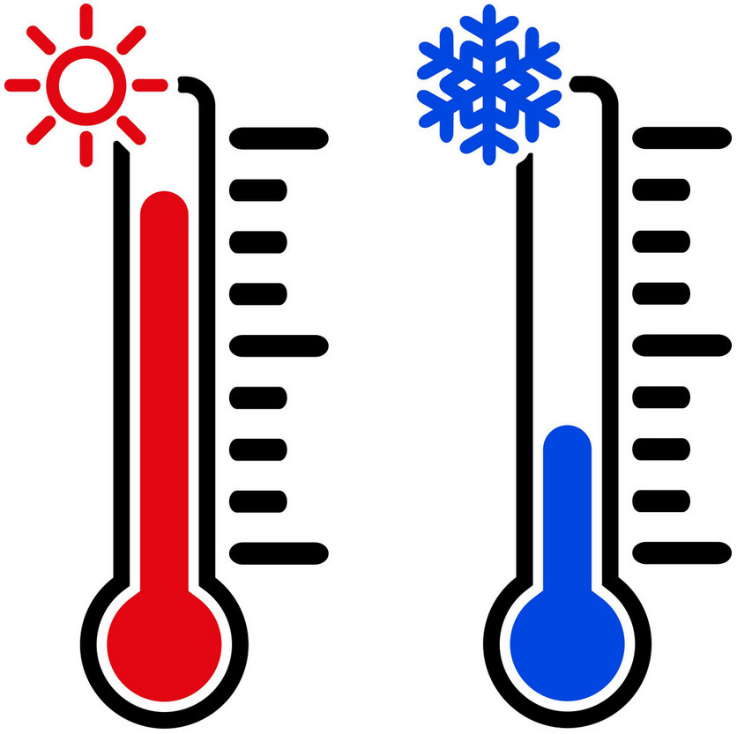



Integration of Environmental Factors
Environmental health is a multi-factorial discipline.
Climate services are biased if factors are not integrated.
Challenge: multi-factorial forecast scheme of health.
Mortality
Morbidity
Births
Occupational
Climate
Air Pollution
Desert Dust
Influenza
Notes:
Environmental health is a multi-factorial discipline.
Heat waves, cold spells, high-pollution episodes, desert dust intrusions, infectious diseases, and many others, cause similar cardiovascular and respiratory diseases.
Considered separately, it is very likely that we overestimate the impact of each environmental factor.
Multi-factorial data integration is a key and still unexplored area in environmental epidemiology and climate services.
The development of a multi-factorial forecast scheme is even more challenging.

Slide 17




Social Dimension of Climate Change Adaptation
Societal factors shape human health vulnerability.
Adaptation might increase health inequalities.
Current projections do not integrate social factors.
Mortality
Morbidity
Births
Occupational
Economy
Recessions
Demography
Inequalities
Notes:
The impact of environmental factors, and particularly climate variability, strongly depends on the exposed population, even in a relatively homogeneous continental like Europe.
Many socioeconomic and demographic factors have historically shaped these impacts.
For example, recessions reduce air pollution in cities, but they also lead to austerity measures and delays in new air pollution policies.
Climate change represents another layer of uncertainty, which can increase inequalities in vulnerability, e.g. poverty, gender, youth/elderly, rural/urban.
Current climate change projections on health do not integrate these factors and changes.

Slide 18




Thank you!
The Blue-Action project has received funding from the European Union’s Horizon 2020 research and innovation programme under grant agreement No 727852
Twitter: @BG10Blueaction
Zenodo: https://www.zenodo.org/communities/blue-actionh2020
www.blue-action.eu

Slide 19
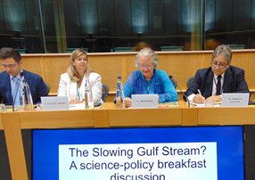
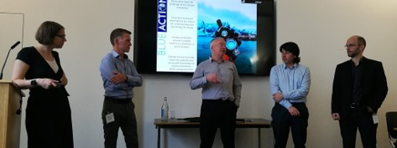

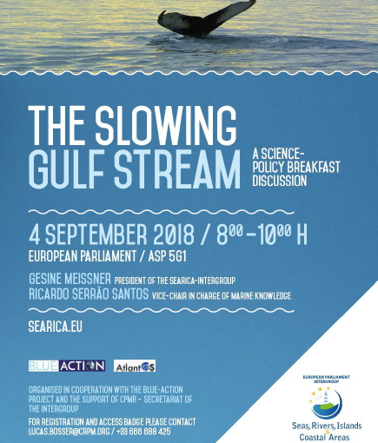
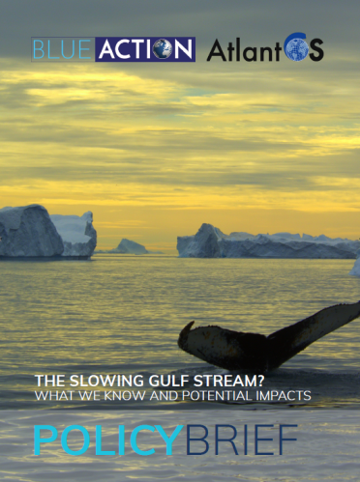
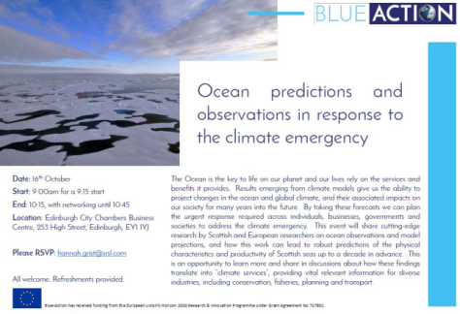
Policy briefings 2018 and 2019
For policy-makers:
Briefing on the Slowing Gulf Stream with SEARICA
For societal engagement: Briefing on ocean observations and predictions
Notes:
Briefing on Slowing Gulf Stream (D8.11) https://zenodo.org/record/1408097
Briefing on ocean observations and predictions (D8.8) https://zenodo.org/record/3816713

Slide 20
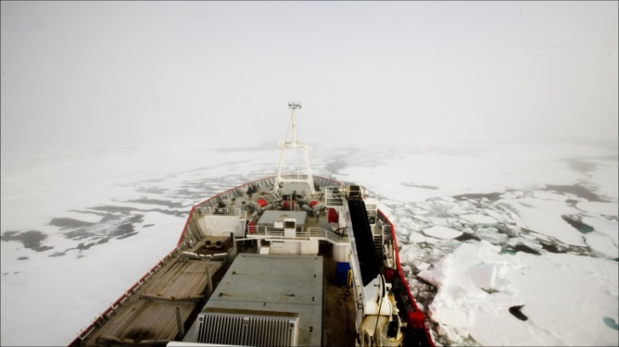

Policy briefings planned in 2020
October 2020
Tipping points, extreme events and uncertainty: how can studying the Arctic help us predict future European climate beyond the mean?
At the European Parliament
In collaboration with
European Parliament Intergroup on Climate Change, Biodiversity and Sustainable Development & ECRA
November 2020
Can we use climate modelling to forecast fish distribution and abundance in the Atlantic?
At the European Parliament
In collaboration with
European Parliament Intergroup on Climate Change, Biodiversity and Sustainable Development

Slide 21
Thank you!
The Blue-Action project has received funding from the European Union’s Horizon 2020 research and innovation programme under grant agreement No 727852
Twitter: @BG10Blueaction
Zenodo: https://www.zenodo.org/communities/blue-actionh2020
www.blue-action.eu

