Slide 1
Case Study 5
Title: Yamal 2040: Scenarios for the Russian Arctic
Lead: Kathrin Stephen, IASS
Presenter: Vilena Valeeva, IASS

Slide 2
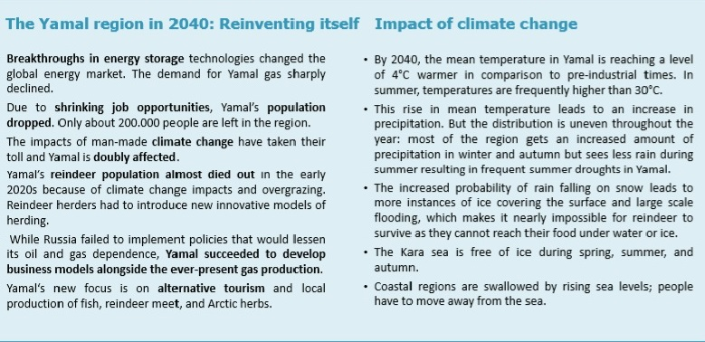
Main Goal
Involve Yamal stakeholders in elaborating complex scenarios for the Yamal region in Arctic Russia, in a co-designed process based on Strategic Foresight, with the support of Blue-Action climate scientists
Notes:
Yamal is a oil and gas-rich region in Western Siberia.
There were three workshops that took place in Moscow and Potsdam in 2017 and 2018. Among the workshop participants, there were and Blue-Action climate scientists and Yamal stakeholders: representatives of local communities, environmental and indigenous rights NGOs, oil and gas sector, and media. At the first two workshops, participants co-developed three alternatve scenarios for the future of the Yamal region. The scenarios are complex and incorporate climate predictions with environmental, social and cultural concerns, economic opportunities, and political and legal developments.
The method used is a Strategic Foresight.

Slide 3
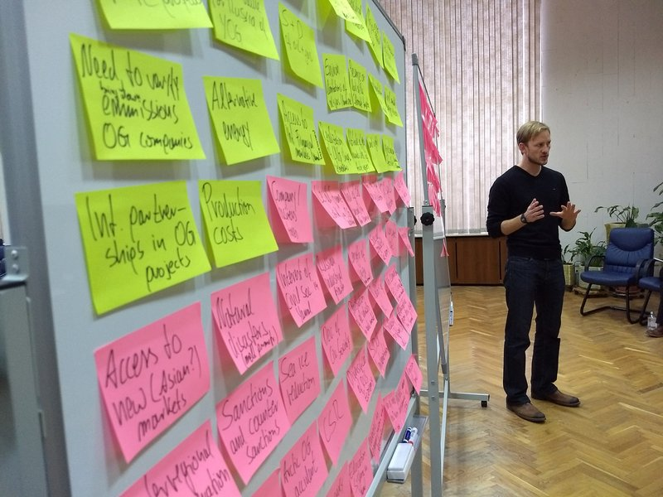
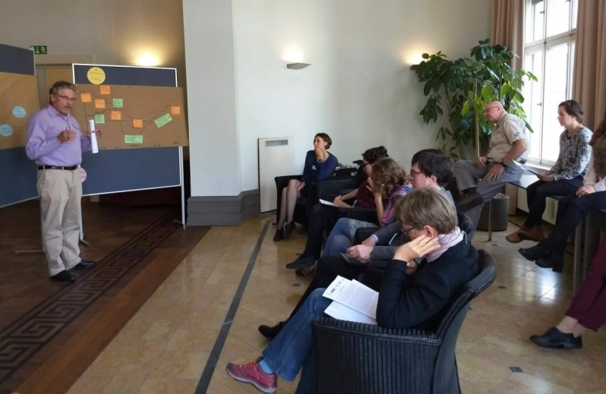
Key features of work done
Yamal stakeholders directly involved (local and indigenous communities, NGOs, local/central government, and international and Russian companies operating in the area…)
Co-design of strategic options for the region
Quantitative and qualitative analysis of the engagement of involved stakeholders
Photo: Kathrin Stephen, IASS
Notes:
The strategic options were develop at the third workshop. They describe what stakeholders could do already today in order to proactively prepare for potential long-term developments in Yamal.

Slide 4
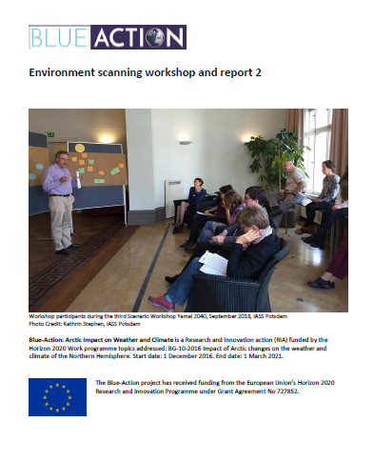
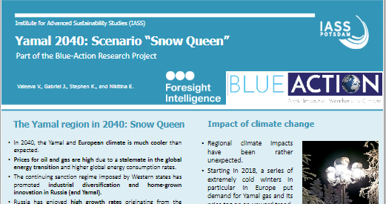
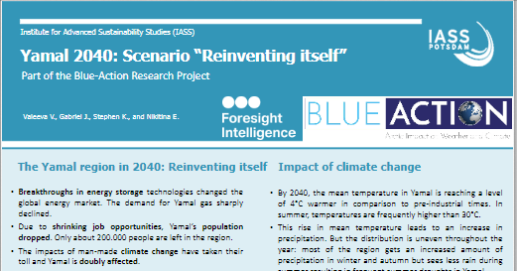
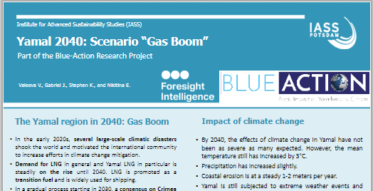
Main Outputs: Three Strategic Scenarios (D5.22)
Notes:
Scenario descriptions: Environment scanning workshop and report Nr. 2 (D5.22). Available in Zenodo: https://zenodo.org/record/3341291
Other relevant documents:
Arctic stakeholder Map (D5.20 ) available in Zenodo: https://www.zenodo.org/record/1164213
Environment scanning workshop and report 1, Blue‐Action Case Study Nr. 5 (D5.21). This deliverable is confidential, but a short summary is available in Zenodo: https//zenodo.org/record/1284592
Quantitative and qualitative analysis of the engagement of stakeholders (D5.23) available in Zenodo https://www.zenodo.org/record/3346855
Three posters on the scenarios:
https://zenodo.org/record/2204432
https://zenodo.org/record/1887608
https://zenodo.org/record/2203886

Slide 5
Main Findings’ Contribution to the Project´s Expected Impacts
Improved stakeholders’ knowledge about the current and possible future impacts of climate change on their activities in Yamal
Enhanced capacity of stakeholders to elaborate strategic options (scenarios) to adapt to the impact of climate change and other changes
Enhanced forecasting capacity of stakeholders: changing the way stakeholders approach the future, learning to be prepared for alternative developments, which require investment in innovation and education

Slide 6
Encouraging local and local and indigenous entrepreneurs to use new innovative business models to develop new economic sectors in Yamal that can meet the future needs of European and global markets
Improved the professional skills and competences of the stakeholders involved (and also of the for early career researchers of Blue-Action!)

Slide 7
Research Gap Nr.1: Strategic Foresight
Strategic Foresight is an effective method for transdisciplinary research that enables incorporation different types of knowledge, including indigenous/local knowledge. There is margin for more development and use.
More integration of methods and disciplines, and more efforts in co-production of knowledge
Use of the Strategic Foresight in a co-design process with focus on:
Arctic regions whose future is very uncertain, because of climate and societal changes/challenges (Greenland)
Innovative and green economic solutions, for example on sustainable food production or development of renewables in the Arctic
Notes:
As Strategic Foresight method is especially effective in dealing wit complex and high uncertain issues

Slide 8
Research Gap Nr. 2: Research & indigenous communities
Lack of knowledge about urban areas in the Arctic: urban–rural connections and dynamics;
Involvement of indigenous communities in research on their territories, opportunities for indigenous science, shared benefit from the outcome of the researches, higher consideration of ethics issues when working with indigenous communities (connect!).

Slide 9
Proposition to DG RTD
Would you be interested in learning from Blue-Action how to use Strategic Foresight methodology for working on the new EU Arctic Strategy?
Notes:
Blue-Action would need help to identify policy advisors at different DG for involving them in the Strategic Foresight Exercise

Slide 10
Thank you!
The Blue-Action project has received funding from the European Union’s Horizon 2020 research and innovation programme under grant agreement No 727852
Twitter: @BG10Blueaction
Zenodo: https://www.zenodo.org/communities/blue-actionh2020
www.blue-action.eu

Slide 11
Potential input of CS5 in the updated EU Arctic Strategy
International and European business actors in the Russian Arctic will profit from business environment with low political risks
It is important to promote and facilitate dialogue between Russian and international partners on variety of topics and different administrative levels
It is important to promote and invest in education among Arctic communities. Only through education can the local population increase its awareness of future challenges and strengthen adaptation capabilities
Notes:
As Strategic Foresight method is especially effective in dealing wit complex and high uncertain issues

