Slide 1
Research Gaps and contribution to Green Deal elements
Lead: Blue-Action
Steffen M. Olsen (DMI), Chiara Bearzotti (DMI)

Slide 2
European Green Deal: response to the challenge
”The atmosphere is warming and the climate is changing with each passing year.
One million of the eight million species on the planet are at risk of being lost.
Forests and oceans are being polluted and destroyed”

Slide 3
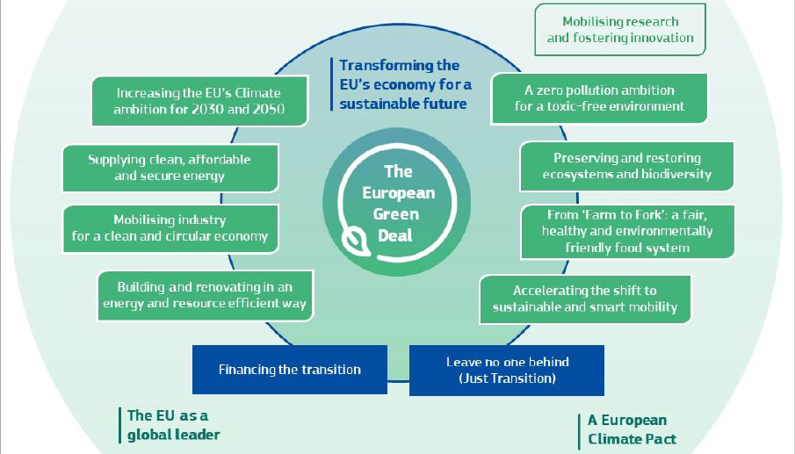
Topics proposed by Blue-Action as research priorities can provide contribution to
the several elements of Green Deal listed below.
We have highlighted HOW and WHERE to in blue in the following slides

Slide 4
Blue-Action identified research gaps
AMOC and Ocean Observations
Scalability of
Climate Services
AMOC fingerprints
Observing the AMOC
Beyond the AMOC
Scalability of fish forecasts
Human Health
Arctic Weather and Climate
Human health and adaptation
Research & indigenous communities
Arctic weather systems and their extremes
Arctic (Polar) warming
Predictability and Model Uncertainty
Safe Operations in the Arctic

Slide 5
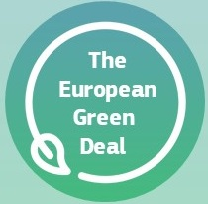
AMOC and Ocean Observations
Arctic Weather and Climate
Scalability of Climate Services
Human health and adaptation

Slide 6
Green Deal Elements
Topics proposed by Blue-Action as research priorities can provide contribution to
“Mobilising research and fostering innovation”
We have highlighted HOW and WHERE to in blue in the following slides

Slide 7
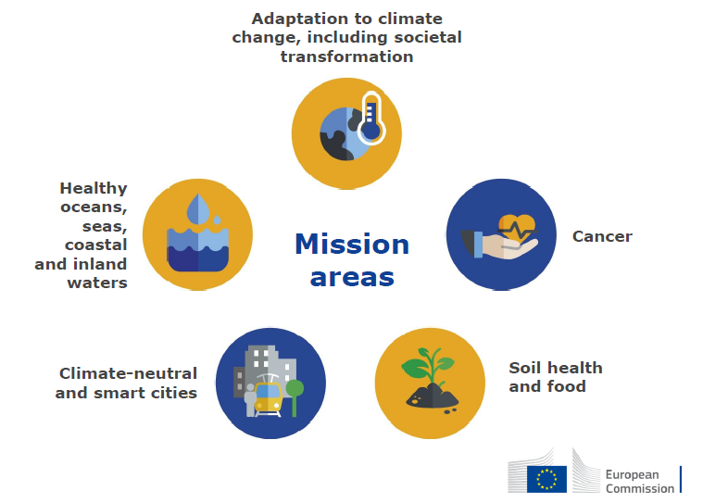
Mobilise research & foster innovation
Horizon Europe four ‘Green Deal Missions’
deliver large-scale changes (areas: adaptation to climate change, oceans, cities and soil)
bring together a wide range of stakeholders (incl. citizens and regions)
Focus on new technologies, sustainable solutions and disruptive innovation
Large-scale deployment and demonstration of new technologies across sectors and across the single market
Building new innovative value chains

Slide 8
EU Research & Innovation Agenda
New approaches:
Experimentation
Working across sectors and disciplines (systemic approach)
Involvement of local communities in working towards a more sustainable future, in initiatives that seek to combine societal pull and technology push

Slide 9
Accessible and interoperable data are at the heart of data-driven innovation
Data +
infrastructure (supercomputers, cloud, ultrafast networks) +
artificial intelligence solutions
= facilitate evidence-based decisions and expand the capacity to understand and tackle environmental challenges
Unlock benefits of digital transformation to support the ecological transition

Slide 10
Earth System Model: predict and manage environmental disasters
“An immediate priority will be to boost the EU’s ability to predict and manage environmental disasters”
To do this, the Commission will bring together European scientific and industrial excellence
“to develop a very high precision
digital model of the Earth”.

Slide 11
Green Deal Elements
Topics proposed by Blue-Action as research priorities can provide contribution to the areas circled in red We have highlighted HOW and WHERE to in blue in the following slides

Slide 12
Decarbonisation of the energy system
Clean energy transition and combination of smart infrastructure and smart integration
Phasing out coal
Decarbonising gas
Focus on Renewables: increasing offshore wind production, smart integration of renewables, energy efficiency and other sustainable solutions across sectors

Slide 13
New EU strategy on adaptation to climate change
Climate change will continue to create significant tress in Europe in spite of the mitigation efforts.
Focus on:
Strengthening the efforts on climate-proofing, resilience building, prevention and preparedness
Influencing public and private investments, including nature-based solutions
data access for developing instruments to integrate climate change in risk management practices

Slide 14
Climate neutral and circular economy
Job-intensive economic activities: to be expanded
Energy-intensive sector: to be decarbonised and modernised
Ressource-intensive sector: sustainable product policy, re-use or recycle plastic
Integrated single marked for by-products and secondary raw materials
Digital technologies are key: AI, 5G, cloud and edge computing, IoT, devices for monitoring air and water pollution
Climate and ressource frontrunners for first commercial breakthrough technologies by 2030
Strategic value chains are essential (battery value chain)

Slide 15
Accelerating the shift to sustainable and smart mobility
Transport accounts for 25% of GHG emissions in Europe. For climate neutrality, 90% reduction in emissions needed by 2050
Freight operations: Shift to rail and inland waterway, and short-sea shipping, multimodal transport
Urban areas: Smart traffic management, automated and connected multimodal mobility
Transport should become less polluting

Slide 16
From Farm to Fork A fair, healthy and environmental friendly food system
European food must remain safe, nutritious and of high quality. It must be produced with minimum impact on nature
Farmers and fishermen are key to managing the transition
Develop innovative farming and fishing techniques that protect harvest from pests and diseases
Strengthen efforts to tackle climate change, protect the environment and preserve biodiversity
Achieve circular economy (food processing and retail sectors)
Stimulate sustainable food consumption
Notes:
2.1.6.

Slide 17
Preserving and restoring ecosystems and biodiversity/1
Drivers of biodiversity loss: use of land/sea, exploitation of natural resources, climate change
Biodiversity strategy 2020
Farm to Fork strategy 2020
Common Fisheries Policy: reduce the adverse impacts that fishing can have on ecosystems, especially in sensitive areas
Support to more connected and well-managed marine protected areas
Notes:
EU forest strategy
Communication on Stepping up EU Action to Protect and Restore the World’s Forests COM/2019/352 final
EU guidelines SWD (2019)305 FINAL “EU guidance on integrating ecosystems and their services
2020 United Nations Ocean Conference in Portugal mportance of action on ocean issues.

Slide 18
Preserving and restoring ecosystems and biodiversity /2
Inputs to ‘blue economy’ are central in:
Alleviating the demand on EU land resources
Tackling climate change
Improving the use of aquatic and marine resources and by promoting the production and use of new sources of protein that can relieve pressure on agricultural land
Notes:
EU forest strategy
Communication on Stepping up EU Action to Protect and Restore the World’s Forests COM/2019/352 final
EU guidelines SWD (2019)305 FINAL “EU guidance on integrating ecosystems and their services
2020 United Nations Ocean Conference in Portugal mportance of action on ocean issues.
IPCC SROCC report Special Report on the Ocean and Cryosphere in a Changing Climate

Slide 19
Preserving and restoring ecosystems and biodiversity /3
Oceans’ role in
mitigating and adapting to climate change is increasingly recognised
Lasting solutions to climate change require greater attention to nature-based solutions including healthy and resilient seas and oceans
Notes:
EU forest strategy
Communication on Stepping up EU Action to Protect and Restore the World’s Forests COM/2019/352 final
EU guidelines SWD (2019)305 FINAL “EU guidance on integrating ecosystems and their services
2020 United Nations Ocean Conference in Portugal mportance of action on ocean issues.
IPCC SROCC report Special Report on the Ocean and Cryosphere in a Changing Climate

Slide 20
Leave no one behind: Education and training
Engage with wider community, schools, families on the changes for a transition
Competence framework to develop skills and attitudes on climate change and sustainable development
Re-skilling and upskilling of workforce to reap the benefits of the ecological transition (from declining sectors to growing ones)
Enhance the employability in the green economy

Slide 21
Thank you!
The Blue-Action project has received funding from the European Union’s Horizon 2020 research and innovation programme under grant agreement No 727852
Twitter: @BG10Blueaction
Zenodo: https://www.zenodo.org/communities/blue-actionh2020
www.blue-action.eu

