Slide 1
WP2
Lower latitude drivers of Arctic changes
Lead: Karin Margretha H. Larsen (HAV) and Gerard McCarthy (NUIM)
Presenter: Karin Margretha H. Larsen (HAV)

Slide 2
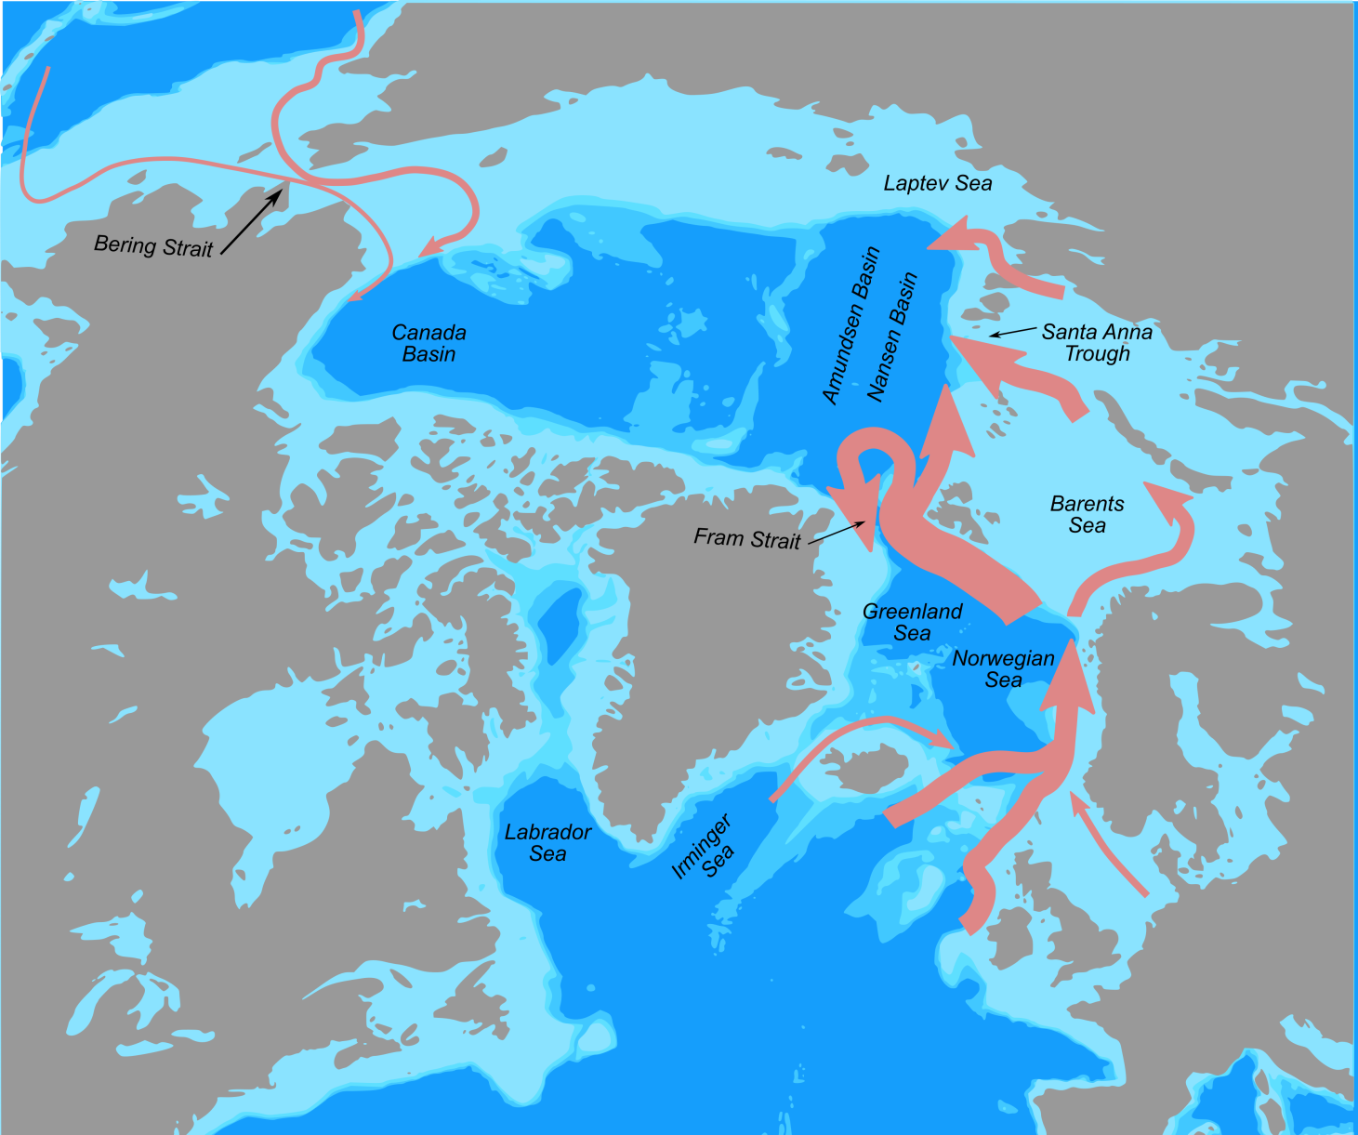
Introduction
WP2 objectives focus on heat transports towards the Arctic, with a focus on the ocean.
Understanding the processes of how the ocean moves heat is key to this.
credits: Gerard McCarthy (NUIM)

Slide 3
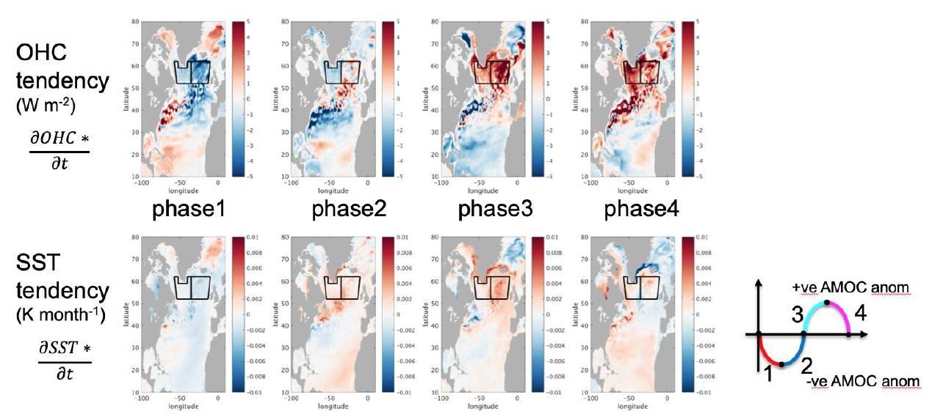
Main Findings’ Contribution to the Project´s EI
Improve capacity to predict the weather and climate of the Northern Hemisphere, and make it possible to better forecast of extreme weather phenomena
Model AMOC anomaly composited into four phases
Ocean Heat Content and Sea Surface Temperature decadal variations in the subpolar NA are dominated by AMOC variability
Moat et al. (2019)

Slide 4
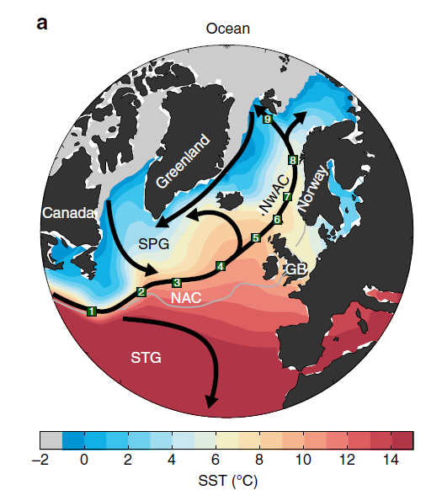
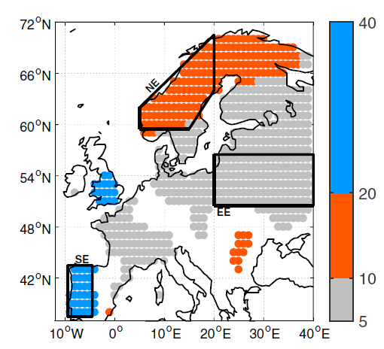
Main Findings’ Contribution to the Project´s EI
Improve capacity to predict the weather and climate of the Northern Hemisphere, and make it possible to better forecast of extreme weather phenomena
Norwegian Sea SST explained by subpolar NA conditions. Improves predictability e.g. over land.
Dominant time scales of SAT (yrs)
Årthun et al. (2017, 2018)

Slide 5
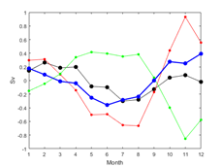
Main Findings’ Contribution to the Project´s EI
Improve the capacity of climate models to represent Arctic warming and its impact on regional and global atmospheric and oceanic circulation
New compilation of available observational data (incl. ADCP, drifter and satellite altimetry data) sheds light on the Iceland-Faroe Ridge flow structure
For the first time, eddy per-mitting simulation (NEMO 1/12°) show a seasonality consistent with the observations.
This work improves representation of Arctic – ’lower latitude’ ocean linkages (D2.3).
Net sim.
Obs

Slide 6
Main Findings’ Contribution to the Project´s EI
Improve the uptake of measurements from satellites by making use of new Earth observation assets
By combining, comparing or complementing in-situ observations from RAPID (D2.1, D2.7), OSNAP (D2.2) and the Greenland-Scotland Ridge (GSR) Transport Mooring Arrays (D2.3, D2.8) and data from existing and new Earth observations
This is used to assess model performance and produce a valid view of ocean heat anomaly propagation towards the Arctic

Slide 7
Main Findings’ Contribution to the Project´s EI
Lead to optimised observation systems for various modelling applications
Through the cost-benefit analysis of the RAPID and OSNAP arrays (D2.7 – due PM42)
Through the optimization of the GSR inflow arrays (D2.8 – due PM42)
Through the combination of various in-situ and satellite data sets with the aim to produce better observational time series products.
  Most of these products are available on-line and some updated in near real time.

Slide 8
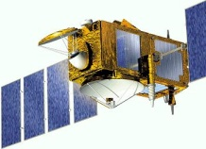
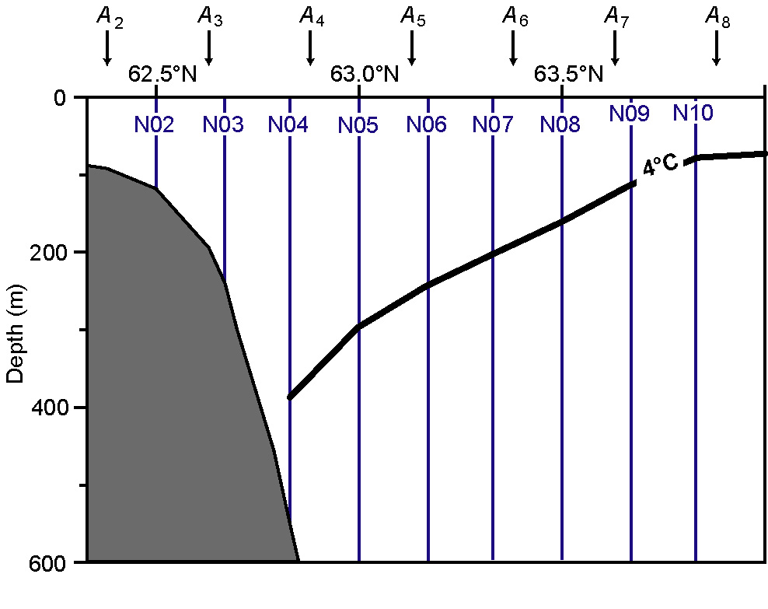
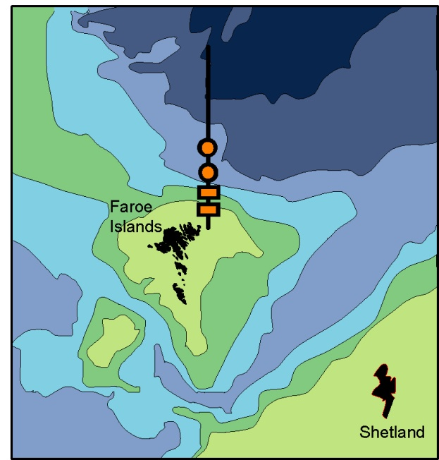
Main Findings’ Contribution to the Project´s EI
Lead to optimised observation systems for various modelling applications
The Faroe Current – combination of various in situ and satellite data (D2.8)
Data upload
from vessel
NE
PIES (long term deployment)
ADCP

Slide 9
Research Gaps
Track the propagation and evolution of the recent large freshening event, with focus on potential impact e.g. on ocean circulation in the wider Arctic, incl return flow
The deeper parts of AMOC and transports of e.g. carbon and other EOVs
Improved understanding of e.g.
  ocean linkages (linking the observational arrays)
  atmosphere-ice-ocean interaction
Improved model bathymetry
More observations are needed to constrain the models
  Better funding opportunities for in-situ observations outside Arctic

Slide 10




Thank you!
The Blue-Action project has received funding from the European Union’s Horizon 2020 research and innovation programme under grant agreement No 727852
Twitter: @BG10Blueaction
Zenodo: https://www.zenodo.org/communities/blue-actionh2020
www.blue-action.eu

