Slide 1
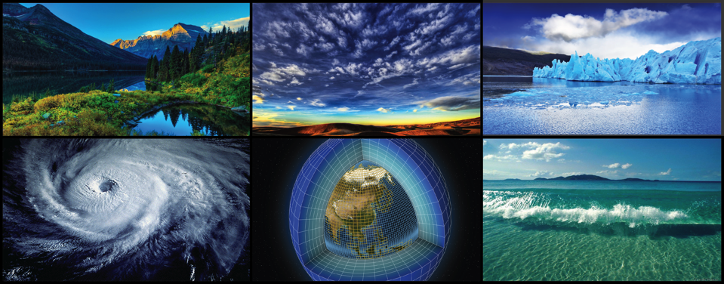
WORLD CLIMATE RESEARCH PROGRAMME
Guy P. Brasseur, Chair WCRP/JSC
Max Planck Institute for Meteorology,
Hamburg, Germany
National Center for Atmospheric Research
Boulder CO, USA

Slide 2
History of WCRP
WCRP was established in 1980 under the joint sponsorship of the International Council for Science (ICSU) and the World Meteorological Organization (WMO). In 1993, The Intergovernmental Oceanographic Commission (IOC) of UNESCO became a sponsor as well.

Slide 3
WCRP’s mission….
... is to facilitate analysis and prediction of Earth system variability and change for use in an increasing range of practical applications of direct relevance, benefit and value to society.
The two overarching objectives of the WCRP are:
to determine the predictability of climate
to determine the effect of human activities on climate

Slide 4
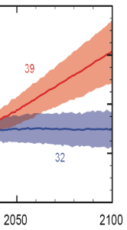
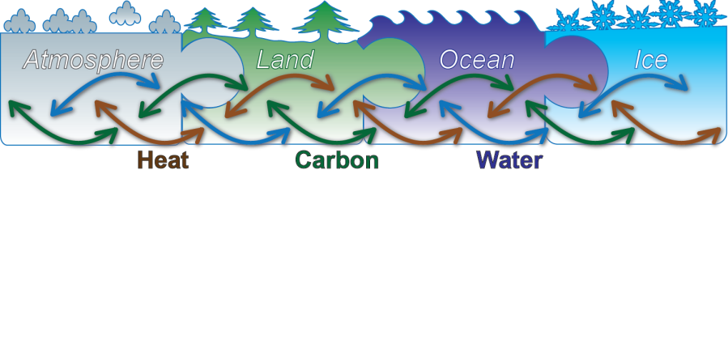
Role of WCRP
WWRP
IPCC
Week
Season
Decade
Century

Slide 5
Role of WCRP
Multi-scale Predictions
Models
Observations
Process Studies
Week
Season
Decade
Century

Slide 6
WCRP Structure
Joint Scientific Committee
Joint Planning Staff
Modeling Advisory Council
Data Advisory Council
Working Groups on: Coupled Modeling (WGCM), Numerical Experiment (WGNE), Regional Climate (WGRC), Seasonal to Interannual Prediction (WGSIP)
CliC
Cryosphere-
Climate
CLIVAR
Ocean-
Atmosphere
GEWEX
Land-
Atmosphere
SPARC
Troposphere -Stratosphere

Slide 7
CLIVAR
Climate and Ocean: Variability, Predictability and Change
to understand the dynamics, the interaction, and the predictability of the coupled ocean-atmosphere system
Research Foci:
Decadal variability and predictability of ocean and climate variability
Marine biophysical interactions and dynamics of upwelling systems
Regional Sea Level Change and Coastal Impacts
Consistency between planetary energy balance and ocean heat storage
ENSO in a changing climate
Intraseasonal, seasonal and interannual variability and predictability of monsoon systems
El Nino comparison 1997 vs. 2015, NASA Visualization Lab

Slide 8
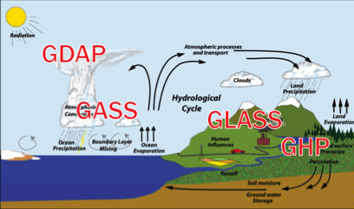
GEWEX
Global Energy and Water Cycle Exchanges Project
focuses on the atmospheric, terrestrial, radiative, hydrological, coupled processes, and interactions that determine the global and regional hydrological cycle, radiation and energy transitions, and their involvement in climate change.
Focus areas:
- Water and Energy Cycles and Processes
- Observations and Predictions of Precipitation
- Global Water Resource Systems
- Changes in Climate and Weather Extremes
GEWEX panels:
Notes:
Observations and Predictions of Precipitation: How can we better understand and predict precipitation variability and changes?
Global Water Resource Systems: How do changes in land surface and hydrology influence past and future changes in water availability and security?
Changes in Extremes: How does a warming world affect climate extremes, esp. droughts, floods, and heat waves, and how do land area processes, in particular, contribute?
Water and Energy Cycles and Processes: How can understanding of the effects and uncertainties of water and energy exchanges in the current and changing climate be improved and conveyed?

Slide 9
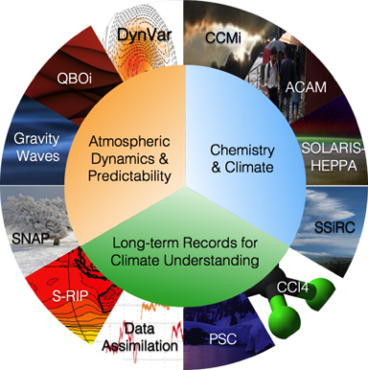
SPARC
Stratosphere-troposphere Processes And their Role in Climate
coordinating international efforts to bring knowledge of the atmosphere to bear on issues regarding climate variability and prediction
Themes:
- Climate variability and change and its impact on the atmosphere
- Ozone
- Atmospheric chemistry and aerosols
- Polar atmospheric processes

Slide 10
CliC
Climate and Cryosphere
Understanding the changing cryosphere and its climate connections
Four main aims for the upcoming future:
1. Improved understanding and quantification of the role of the cryosphere in the global climate system, its variability and change.
2. Improved utilization of cryospheric observations as indicators of global and regional climate change.
3. Improved understanding of the physical, chemical and other processes that govern behavior of the cryosphere, and the representation of these processes in Earth System Models.
4. Improved ability to make quantitative predictions and projections of the cryosphere in a changing climate.
NASA visualization Lab

Slide 11
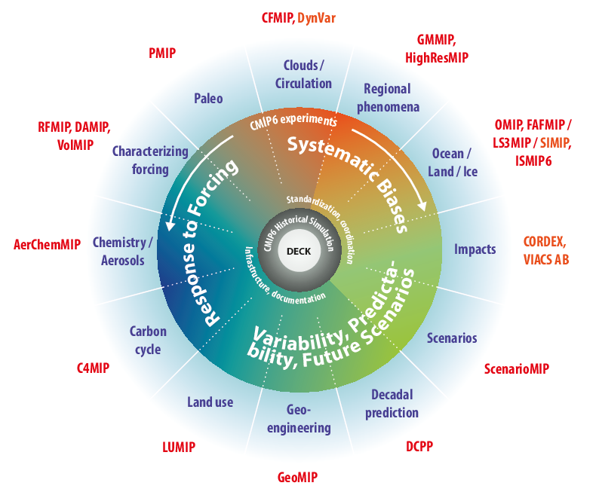
21 CMIP6-Endorsed MIPs
Diagnostic MIPs
Notes:
VIA AB includes members from the Global Programme of Research on Climate Change Vulnerability, Impacts and Adaptation (PROVIA), the IPCC Task Group on Data and Scenario Support for Impact and Climate Analysis (TGICA), the World Climate Research Programme (WCRP) Working Group on
Regional Climate (WGRC), the International Committee On New Integrated Climate change assessment Scenarios (ICONICS), and the Climate Services community

Slide 12
CORDEX
COrdinated DOwnscaling EXperiment
CORDEX advances and coordinates the science and application of regional climate downscaling through global partnerships.
Notes:
12

Slide 13
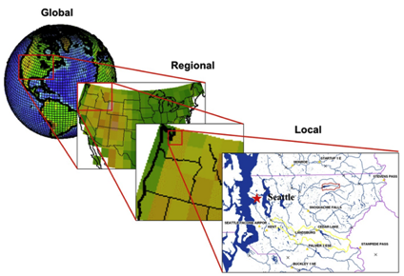
CORDEX
COordinated Regional climate Downscaling Experiment
to advance and coordinate the science and application of regional climate downscaling through global partnerships
Main aims:
To better understand relevant regional/local climate phenomena, their variability and changes, through downscaling.
To evaluate and improve regional climate downscaling models and techniques
To produce coordinated sets of regional downscaled projections worldwide
To foster communication and knowledge exchange with users of regional climate information

Slide 14
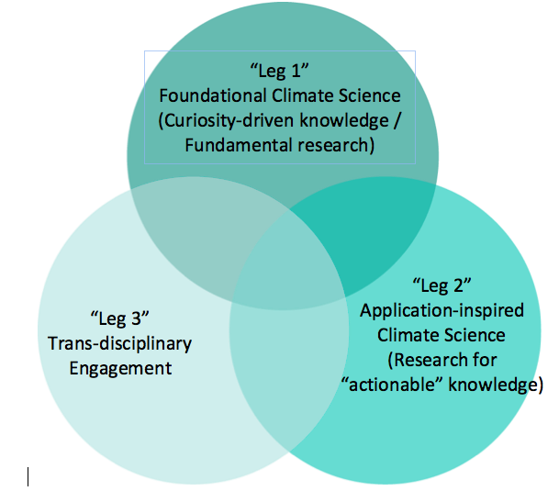
Regional Approaches for WCRP

Slide 15
Regional Approaches for WCRP
Leg 1: WCRP will build on past and ongoing studies by the climate research community to advance knowledge on climate change and variability, and project trajectories of associated changes in different regions of the world.
Leg 2: WCRP seeks to advance fundamental understanding relevant to regional socio-ecological challenges involving the climate system by working with experts from different natural science disciplines.
Leg 3: WCRP will work with multi-disciplinary communities to engage in a dialogue with high-level boundary organizations that need climate and related information.
Integration: WCRP will organize an international call to appoint a coordinator for WCRP regional activities, as soon as possible.

Slide 16
WCRP Core Projects and Grand Challenges
Joint Scientific Committee
Joint Planning Staff
Modeling Advisory Council
Data Advisory Council
Working Groups on: Coupled Modeling (WGCM), Numerical Experiment (WGNE), Regional Climate (WGRC), Seasonal to Interannual Prediction (WGSIP)
CliC
Cryosphere-
Climate
CLIVAR
Ocean-
Atmosphere
GEWEX
Land-
Atmosphere
SPARC
Troposphere -Stratosphere
Melting Ice & Global Consequences
Regional Sea Level & Coastal Impacts
Water for Food Baskets
Weather & Climate Extremes
Clouds, Circulation & Climate Sensitivity
Near-Term Prediction (Decadal)
Carbon & Climate

Slide 17
MELTING ICE and GLOBAL CONSEQUENCES
How will melting ice respond to, and feedback on, the climate response to increasing greenhouse gases, and what will the impacts be on:
- Permafrost and the Global Carbon Cycle
- Ice Sheets
- Glaciers
- Rising Sea Level
- Sea Ice and Snow interaction
Snow and ice are seen as bright blue, while vegetation appears green and bedrock brown. Gray stripes on the glacier surface represent rocky debris. NASA visualization Lab

Slide 18
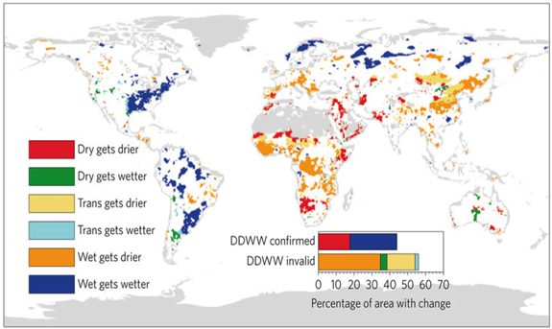
WATER and FOOD BASKETS
How can we better understand and predict precipitation variability and changes?
How do changes in land surface and hydrology influence past and future changes in water availability and security?
Greve et al. 2015

Slide 19
REGIONAL SEA LEVEL CHANGE and COASTAL IMPACTS
What are the main causes of contemporary regional sea level variability and change?
What is the degree of decadal variability in sea surface height observations and in forecasts?
2003-2008

Slide 20
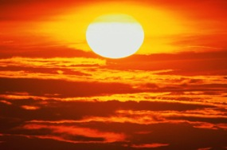
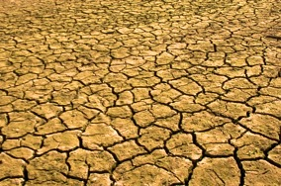
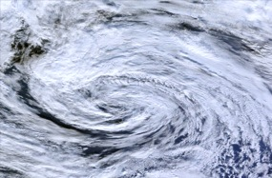
WEATHER and CLIMATE EXTREMES
Are changes in the frequency and intensity of extremes predictable at seasonal to decadal
scale? And how can society best use such
forecasts?
HEAVY RAIN
HEAT WAVES
document
understand
attribute
simulate
What do we understand about the interactions between large-scale drivers and regional-scale land-surface feedbacks that affect extremes?
DROUGHTS
STORMS

Slide 21
CLOUDS, CIRCULATION and CLIMATE SENSITIVITY
How will clouds and circulation respond to global warming or other forcings?
How do clouds couple to circulations in the present climate?
Wind vectors and monthly average CO2 concentrations in 2003. High CO2 concentrations of ~385 ppm are in red, low CO2, about ~360 ppm, is blue. NASA Visualization Lab

Slide 22
NEAR-TERM CLIMATE PREDICTION
To improve the quality of initialized decadal climate information and prediction
To collect, collate, and synthesize the prediction output and tailor information to form the basis of a service that addresses stakeholders’ needs
To develop processes to assess and communicate the degree of confidence and uncertainty in the predictions

Slide 23
CARBON and CLIMATE
What biological and abiological processes drive and control land and ocean carbon uptake?
Can and will carbon feedbacks amplify climate changes during the 21st century?
How will highly vulnerable land and ocean carbon reservoirs respond to a warming climate, to climate extremes and to abrupt changes?
Where does the carbon go?

Slide 24
The Seven Grand Challenges of WCRP
Carbon
and
Climate
Decadal
Prediction
Week
Season
Decade
Century

Slide 25
Post COP-21 Science
COP-21: A major political achievement, based in large part on the knowledge provided by the scientific community.
A major success for our scientific community
After decades of active investigations (e.g., WCRP) and the efforts to communicate the findings (e.g., IPCC):
The science is now widely accepted: All key nations accept the concept of human-induced climate change, even if some large uncertainties remain.
The focus of the research must evolve from “making the case” for “greenhouse warming” to the development and dissemination of regional information needed to minimize risks and to build resilience.

Slide 26
A Shift in the Research Emphasis
The immediate challenge for political and economic leaders is to create the conditions for the sustainable development of the planet (UN Sustainable Development Goals)
Goal 13: “Take urgent action to combat climate change and its impacts”
Ensuring sustainable development requires that we understand the processes that govern the multi-scale variability and changes associated with the dynamical Earth system.
It also requires the development of a “smart” end-to-end information system based on
a strong fundamental research component (basic research, high resolution ocean-land-atmosphere observation system, advanced Earth System models with regional predicting capability, process studies)
a translation system that integrates knowledge from different disciplines, addresses questions from different actors and supports boundary organizations (climate services, GFCS, IPCC, Future Earth, etc.).

Slide 27
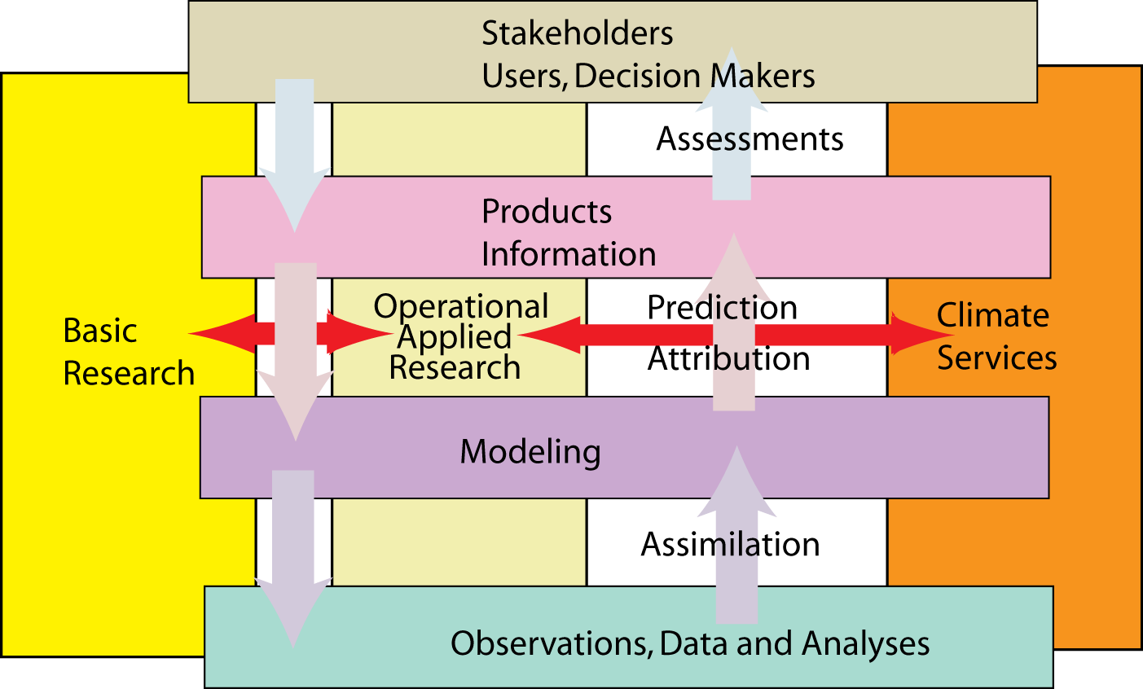
Towards a Smart End-to-End Climate Information System
K. Trenberth

Slide 28
A Shift in the Research Emphasis and in the Message to Society
We need therefore to recalibrate the message that we are giving to the outside world.
Time is mature
to start develop a new perspective for WCRP that responds to the societal challenges of the next decades, and puts more emphasis on regional aspects, on natural variability, and on possible surprises.
to redefine a challenging vision for the future of the Programme.
This should be initiated soon and be launched at the occasion of a large WCRP Open Science Conference that will celebrate the 40th anniversary of the Programme in 2020.

Slide 29
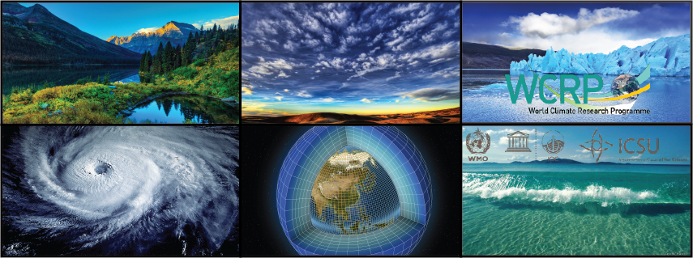
WORLD CLIMATE RESEARCH PROGRAMME
Thank You

