Slide 1
Blue-Action – WP2
Lower latitude drivers of Arctic changes
Report from breakout session
Lead: Karin Margretha H. Larsen, HAV
Co-lead: Gerard McCarthy, NERC/NOC

Slide 2
WP2 | Deliverables | Lead
D2.1 | Model-observation and reanalyses comparison at key locations for heat transport to the Arctic | Ben Moat, NERC
D2.2 | Seasonal to decadal variability of the subpolar gyre | Stuart Cunningham, SAMS
D2.3 | Processes and flow over the Iceland-Faroe Ridge | Steffen Olsen, DMI
D2.4 | Synthesis and dissemination of ocean and atmosphere heat transport to the Arctic | Wilco Hazeleger, NLeSC
D2.5 | Assessment of Oceanic anomalies of predictive potential | Tor Eldevik, UiB
D2.6 | Oceanic heat anomalies and Arctic sea-ice variability | Christophe Herbaut, CNRS
D2.7 | Cost-benefit analysis of the RAPID and OSNAP arrays | Johannes Karstensen, GEOMAR
D2.8 | Optimization of the GSR inflow arrays | Karin M. H. Larsen, HAV

Slide 3
 | Milestone title | WPs | Lead | Means of verification
MS8 | Assessment of heat transport and distribution in the high Arctic in eddy resolving model | WP2, WP3 | CNRS | Identification of robust metrics
MS9 | Coupled reanalysis of the Arctic climate | WP2, WP3, WP4 | CNRS | Two novel climate reanalyses made available to the project for evaluation (WP2), process analysis (WP3) and predictability studies (WP4)

Slide 4
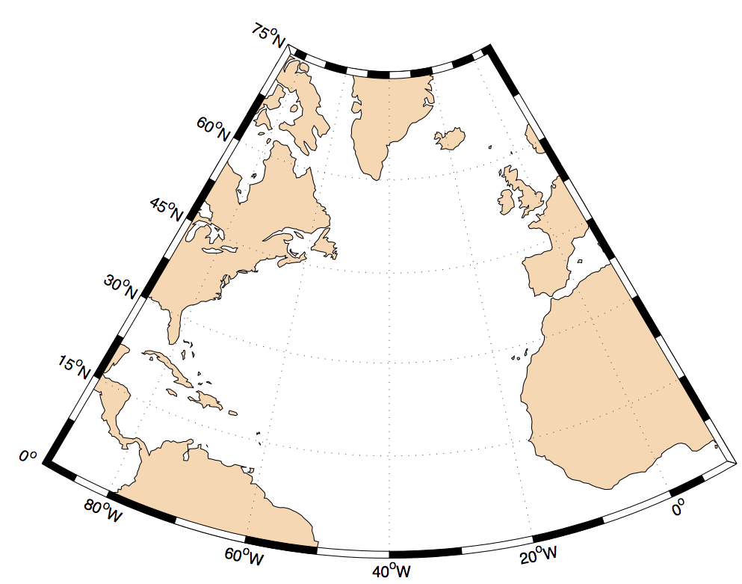
D2.1 Model-observation and re-analyses comparison at key locations for heat transport to the Arctic
Ben Moat, NOC, UK, (Due in M36)
Bering Strait inflow
1) NEMO Ocean only hindcast
1/12° 1958 to 2015
1/12° 1958 to 2015 (ACSIS – JRA forcing)
1/24° ?
2) Three (HadGEM-Charisma) - Coupled simulations
All are 1/12° Ocean N512 Atmosphere
20 year control run
b) 100 year control run
fixed present day CO₂
c) 100 year “all-forced” run to present day
and then scenario (RCP 8.5?)
1950 to 2050
GSR
STATION M
EEL
OSNAP
OVIDE
RAPID ARRAY
3) ARGO/Glider data
4) Satellite data
5) Atmos. Heat transport
REPORT: 36 MONTHS
Notes:
2.1 Assessment of key lower latitude influences on the Arctic and their simulation [Lead: NERC; Participants: UoS, NLeSC, MPI, HAV, GEOMAR, NIOZ, SAMS, MRI, MSS, UHAM, UNIRES, CNRS, DMI, UIB, NCAR, WHOI, MEOPAR] [Start: Month 1, End: Month 36; Deliverables associated to this task: D2.1, D2.2, D2.3, D2.4] At key locations, Blue-Action
*** will compare observations of heat and freshwater transport to state-of-the-art coupled climate models (HadGEM-Charisma, IPSL, CESM) and high resolution ocean-only models (e.g., NEMO (1/24°)).
In-situ ocean data originating from transport mooring arrays (TMAs) and hydrographic GO-SHIP sections will be complimented with remote sensed data from Argo profiling floats, from underwater gliders and satellite data (including existing missions, and new missions data from Jason-3 and Sentinel-3, when they are operational).
***Correspondence, compensation or feedback between these ocean heat transport estimates and atmospheric heat transport will be examined in the coupled model simulations (D2.1) [NERC, MPI, UoS, NLeSC, GEOMAR, SAMS, NIOZ, MRI, HAV, MSS, UHAM, CNRS, UNIRES, UIB, NCAR, WHOI].
¼ degree eqivalents with an N216 atmosphere.
Rcp 8.5
b) go6 and geo7 atmos (25km resolution)
Qunatify different water massess across EEL, OVIDE ?
volcanoes, solar, aerosols, greenhouse gases (ALL FORCED)
Baring strait – University of Washington Rebecca Woodgate ? 0.8Sv inflow and 26 Sv psu
Station M – 1948 to 2009 daily CTD to 1000m, weekly CTD to 2200m. Mooring since 2010 (DNMI?)
Testing ? Is the AMOC realistic ???

Slide 5
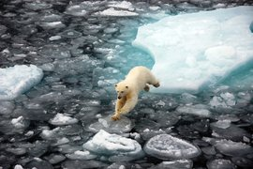
Arctic Impact on Weather and Climate
D2.2: Seasonal to decadal variability of the subpolar gyre
Due Month 36 [Dec 2019]
Contributors: Stuart Cunningham, SAMS (lead),
Johannes Karstensen, GEOMAR, Laura de Steur, NIOZ, Hjálmar Hátún, HAV,
Kerstin Jochumsen, UHAM, Gerard, McCarthy NERC, Steve Yeager, NCAR,
Christophe Herbaut, CNRS, Brad de Young, MEOPAR
Blue-Action will investigate the propagation of warm ocean waters from the subpolar gyre over the GSR and towards the Arctic.
The subpolar gyre circulation will be assessed in order to quantify the atmospheric and oceanic mechanisms that influence its seasonal to decadal-scale variability.
The link between the warm and saline eastern waters and colder and less saline western waters as well as the mechanisms controlling the heat and freshwater transfer from the eastern subpolar gyre to the Greenland-Scotland Ridge will be established through an integrated model-observation analysis, relying on the OSNAP array, the EEL, the OVIDE line and other data sets.

Slide 6
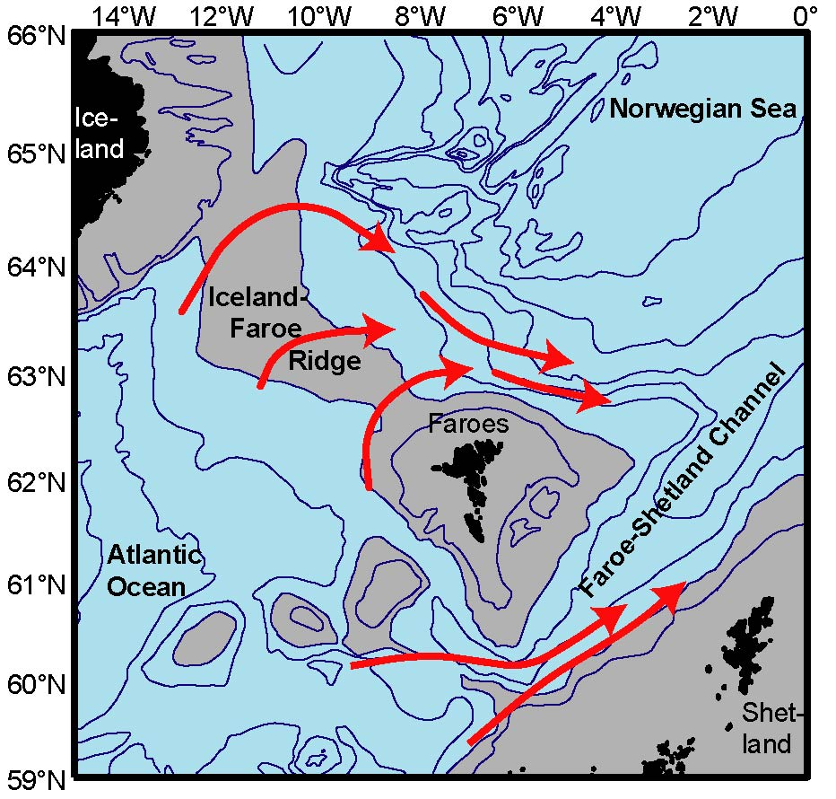
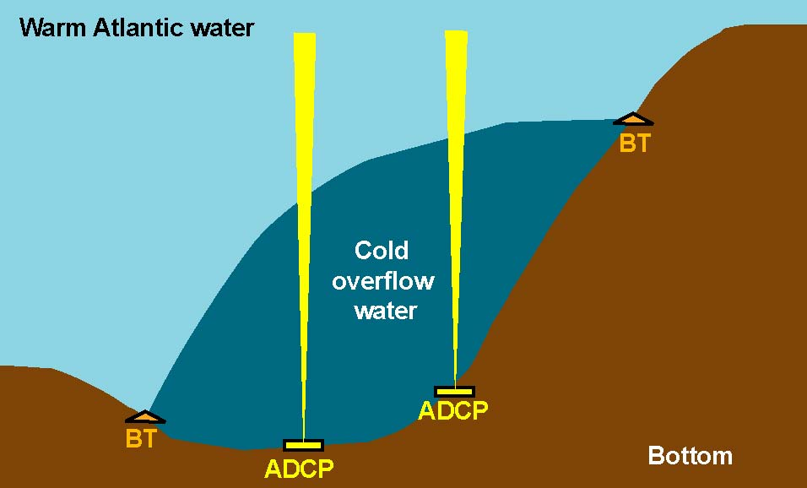
D2.3 Processes and flow over the Iceland-Faroe Ridge
(Steffen Olsen, DMI, Due in M36)
Monitoring Project on the IFR
HAV and DMI. UHAM
Aim to improve models

Slide 7
D 2.4 Synthesis and dissemination ocean and atmospheric heat transports into the Arctic
(Wilco Hazeleger, NLeSC, due in M36)
  Compute meridional heat transports into Arctic and its variability and trends from Reanalysis data (ERA5, ERA20C, ORAS5). Gyre, overturning, moist static energy components.
  Compute same from models participating (CMIP6 DECK and HIGHRESMIP)
  Partners, please provide overview of which fields are available (HADGEM, CESM, EC-Earth, IPSL,…)
  Partners, please provide resolutions (preferably eddy permitting models included)
  Partners, please use original model grid.
  Partly overlap with D2.1 – make sure to use same ocean sections

Slide 8
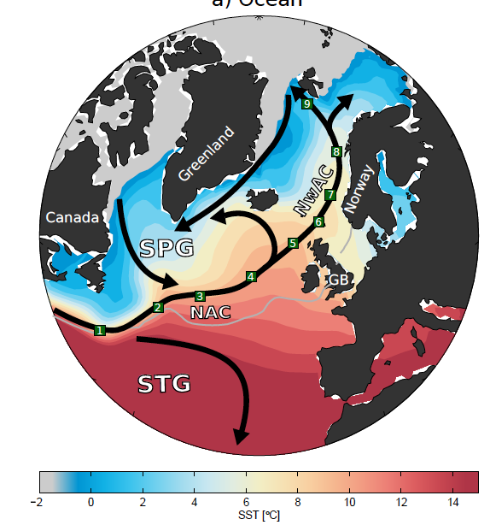
D2.5 Assessment of Oceanic anomalies of predictive potential
Partners: UIB (Tor Eldevik, Due M30), CNRS, HAV, NERSC, UNIRES, NCAR
AIM:
Improve the mechanistic understanding of the formation and propagation of thermohaline anomalies toward the Arctic.
Assess the connectivity between the subpolar North Atlantic and Nordic Seas.
Along-path forcing of anomalies; ocean advection vs air-sea fluxes.
DATA:
Available mooring data and hydrography from the Nordic Seas.
Available observations from GSR (D2.1-2.3)?
Available model data (coupled and ice-ocean; D2.1)?
Årthun et al. in rev.

Slide 9
D2.6 Oceanic heat anomalies and Arctic sea-ice variability
Participants: CNRS (Christophe Herbaut), NERSC, UiB (Due M30)
Deliverable Objectives:
To investigate the link between the oceanic heat transport and sea-ice in the Arctic
predictability in Arctic Sea ice cover related to the poleward extension of the Atlantic surface layer
Basin exchanges in the Nordic Seas and relation with:
Gyre circulation
Sea ice cover
Using the Norwegian Earth System Model (resolution 0.25 degree)
Årthun et al., in rev.

Slide 10
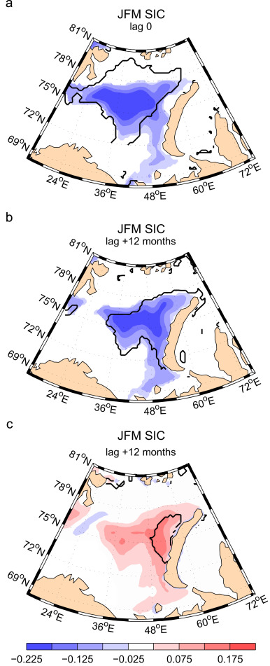
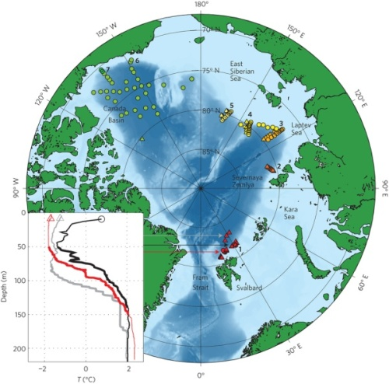
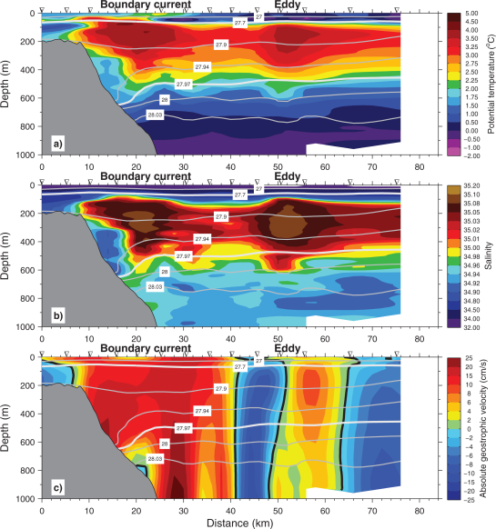
Regression of winter SIC onto previous winter AW temperature at BSO
mechanisms controlling the availability of oceanic heat to the ice
Delayed response of the sea ice cover to heat content anomalies formed in western Barents Sea and reemerging one year later in the NE Barents Sea
Herbaut et al., 2015
Effect of stratification sea ice formation
Localization of microsctructure profiler measurements
Effect of vertical mixing:
Vertical heat fluxes generated by tides over rough topography could reach 50 W/m2 north of Svalbard.
Suggested Positive Feedback between summer and winter ice condition through winter thermal convection (Ivanov,et al., 2016)
Section of T across the boundary current at 30°N in the Nansen Basin in summer
Rippeth et al., 2015
Exchange between the boundary current and shelf:
eddy activity (Tverberg et al. , 2014)
Upwelling of AW along the slope
AW upwelling
Våge et al., 2016

Slide 11
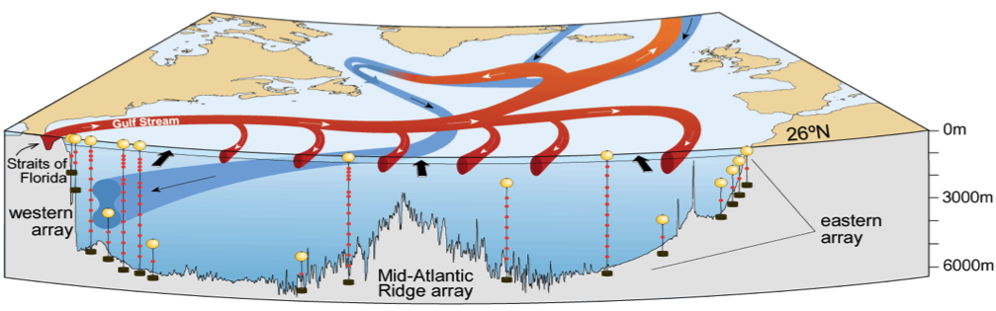
D2.7 Cost-benefit analysis of the RAPID and OSNAP arrays (Johannes Karstensen, GEOMAR, Due M42)
Link up with AtlantOS workshop on gap analysis (2018)

Slide 12
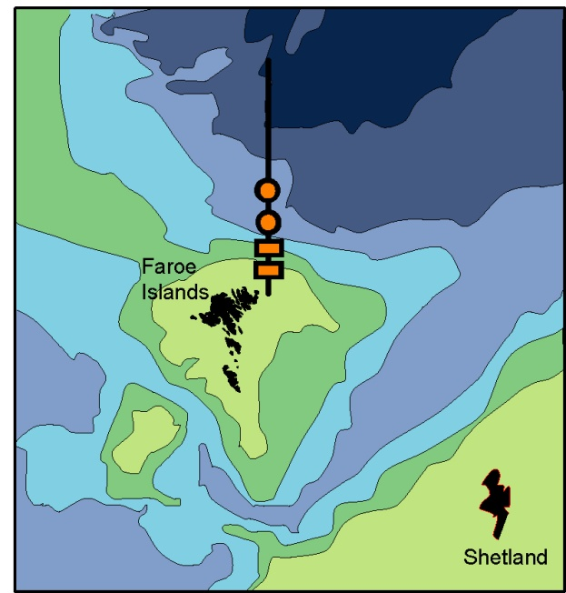
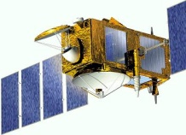
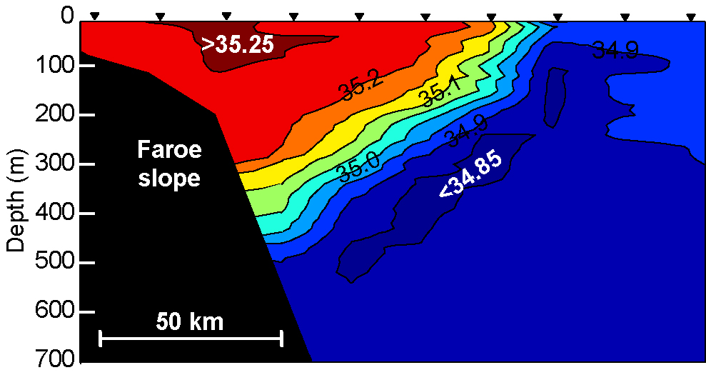
D2.8 Optimization of the GSR inflow arrays (Karin. M. H. Larsen, HAV, Due M42)
Faroe Current monitoring section
Satellite altimetry
Atlantic
Arctic
Bottom temperature
ADCPs: 1997-2015

