Slide 1

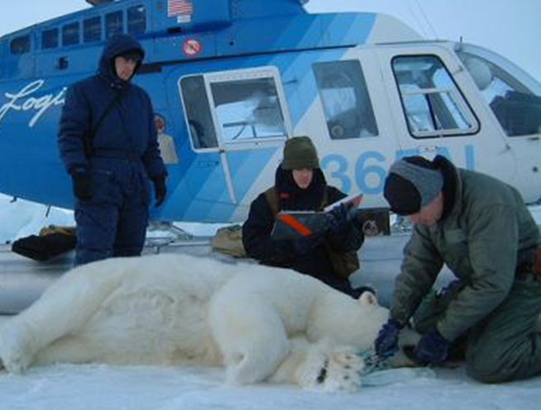

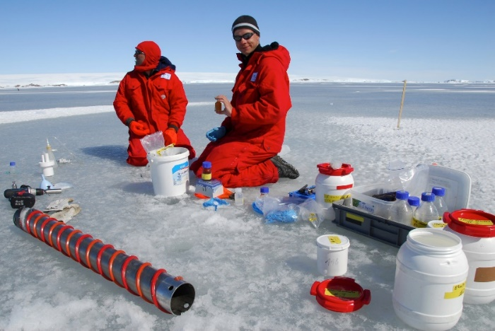

EU-PolarNet
connecting science with society
Co-designed research proposals, involving stakeholders from the outset, will ensure that scientific outcomes
are directly relevant and beneficial to
society and our economies

Slide 2
Our ambition
Initiate, conduct and sustain on-going dialogue and cooperation with all relevant units of the European Commission on Polar topics
Improve the co-ordination of European research in the Arctic and Antarctic to develop an integrated European polar research programme co-designed with all relevant stakeholders
Design a resource-oriented European infrastructure access and usage plan to support an integrated research programme
Improve and strengthen international cooperation in polar research and to implement the Transatlantic Research Alliance

Slide 3
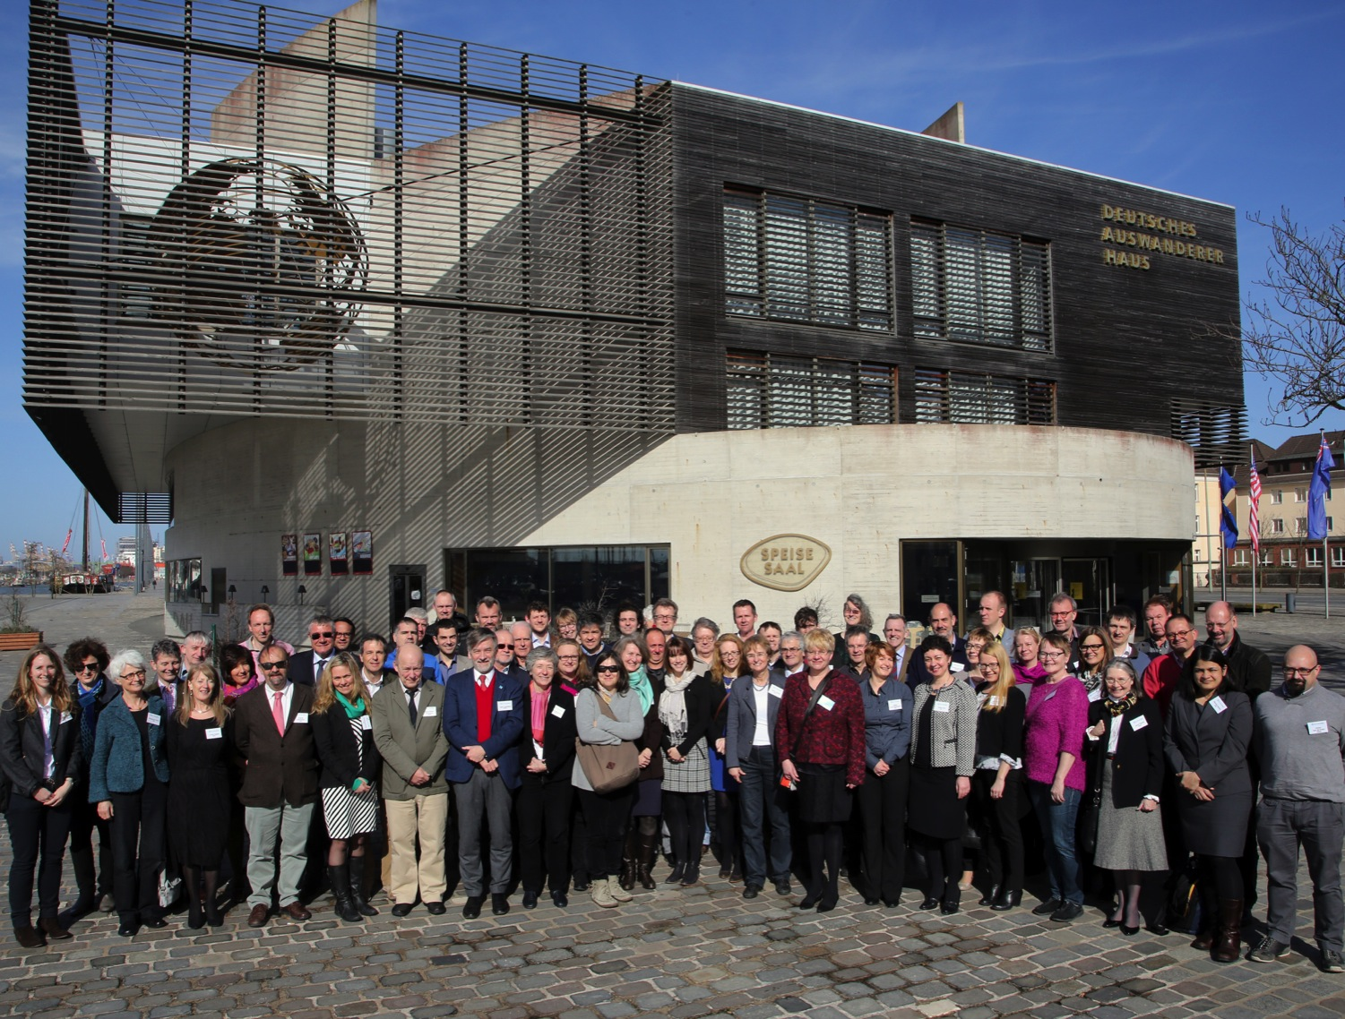
Our consortium

Slide 4

Who we are
The world’s largest consortium of expertise and infrastructure for polar research
17 countries represented by 22 of Europe’s internationally-respected multi-disciplinary research institutions
Professional teams from many disciplines

Slide 5

Affiliated
Partner
The European Polar Board (EPB) is an independent European Organisation of Directors and Managers of the major European National Polar Programmes. It´s mission is to coordinate European Arctic and Antarctic research, optimise the use of European research infrastructures and foster multilateral collaboration
Supports EU-PolarNet with 50 % of its executive secretaries working time and additional financial support
Has implemented action groups to support EU-PolarNet tasks, like e.g. policy advice
Will make sure that the legacy of EU-PolarNet will be reliably sustained

Slide 6

























Our cooperation partners
Polar Knowledge Canada

Slide 7
Work packages
WP4: Interaction with
Stakeholders and end-users
CNR-DTA, Italy
STAKEHOLDERS
WP1: Management of the Consortium, International Integration and Policy Guidance
AWI, Germany
EU-PolarNet
SCIENCE
INFRASTRUCTURES
WP2: Polar Research for
Science and Society
CNRS, France
WP3: Infrastructures,
Facilities and Data
NERC-BAS, UK

Slide 8
Our approach
Public & private decision makers,
research funding organisations,
European Commission
European society,
European policy
EU-PolarNet
Transatlantic &
international
partners, networks,
organisations
Stakeholders and
end-users
Knowledge from EU
and national research
projects
SCAR & IASC
science planning results
National research
plans
Notes:
Approach of the project
1) Providing the background information
Consolidation of knowledge of the current European and international polar research landscape by compiling available information from ongoing research planning initiatives such as ICARP III and SCAR Horizon Scan, national research plans, EU projects
2) Strategic scoping exercise
Identify the key current research gaps and weaknesses, gaps in infrastructure capability and availability, priorities for new research programmes and infrastructure investments to address them. The exercise is carried out in close cooperation with international and transatlantic partners and stakeholders and end-users
3) Outreach to European society, research funders, public and private decision makers by publishing recommendations and providing advice on their questions relating to Polar issues.
This three phase approach will work like a virtuous circle with iterative rounds of dialogue in a series of workshops

Slide 9
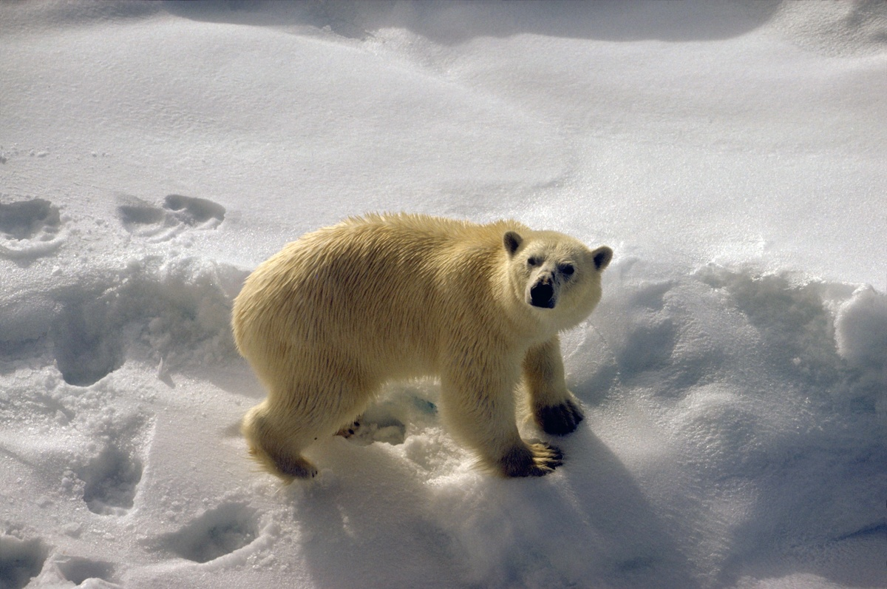
New public deliverables of EU-PolarNet

Slide 10


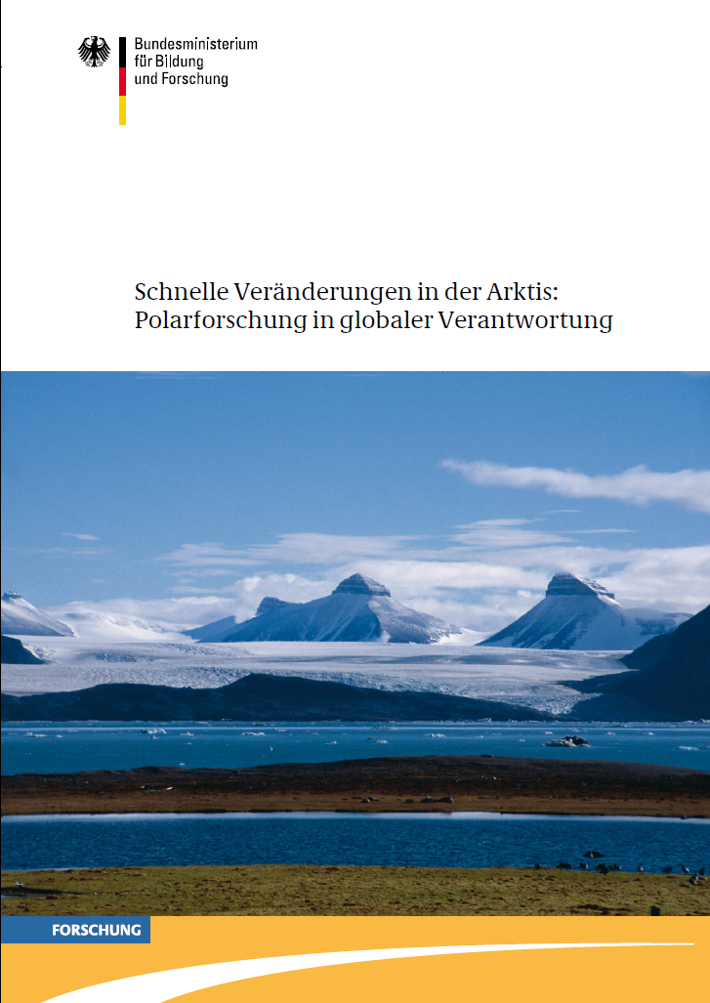
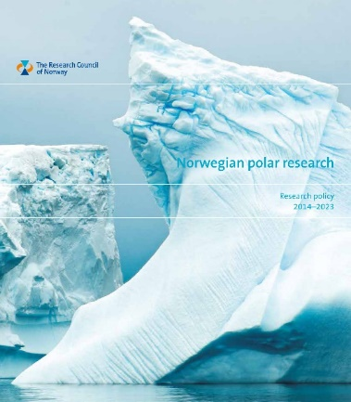
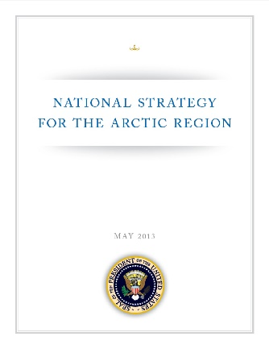
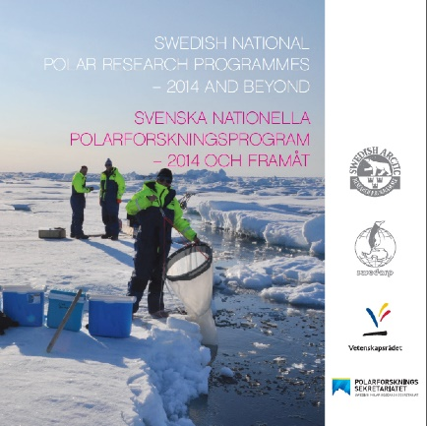



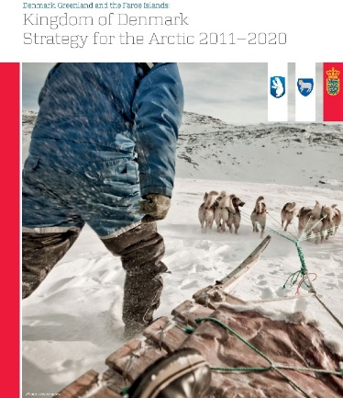
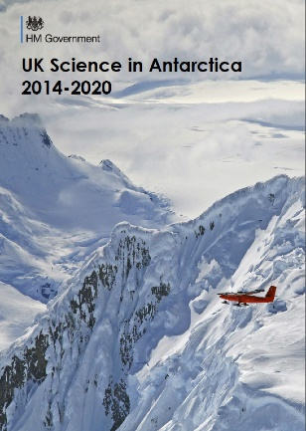

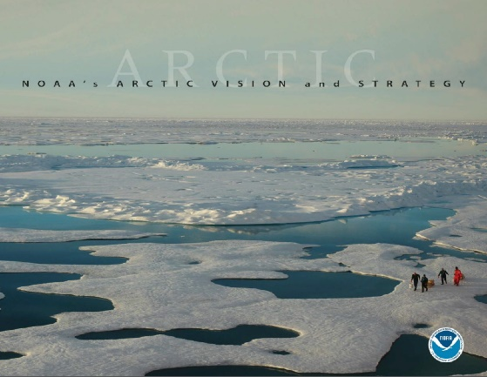
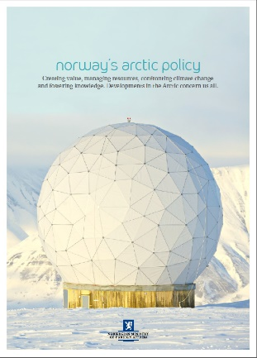
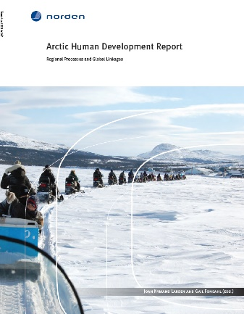
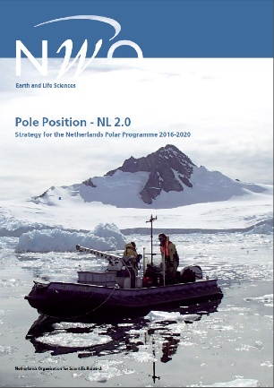


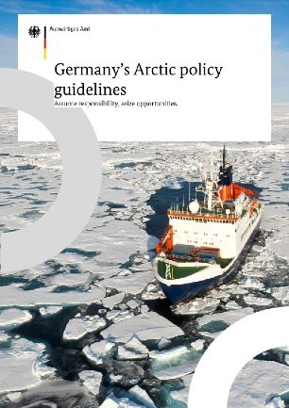






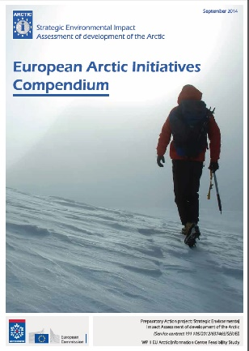
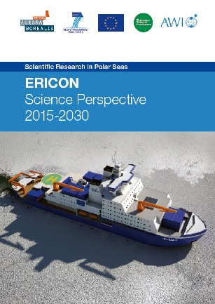
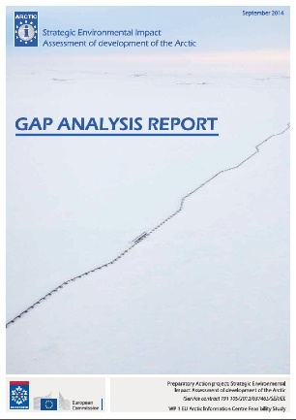
D2.1 Report on prioritised objectives in polar research
D2.1 identified 10 research themes with several key questions and related societal relevance.

Slide 11



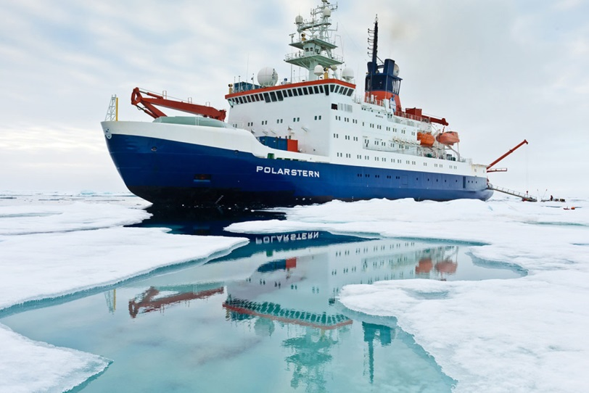
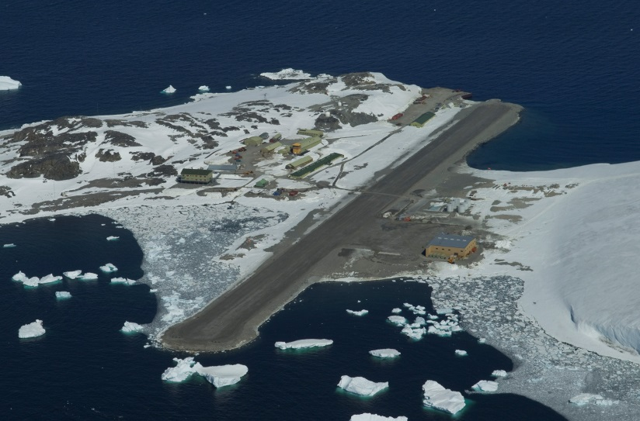

D3.2 European Polar Infrastructure Catalogue
A catalogue of all existing polar infrastructures (stations, research vessels, aircrafts, observatories, autonomous instrumentation on land, in air and ocean research...) for both poles has been established in cooperation with:

Slide 12
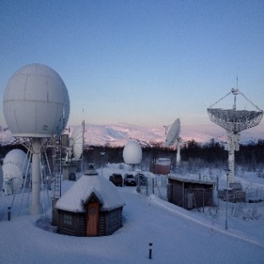
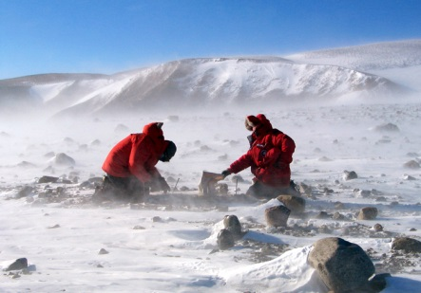
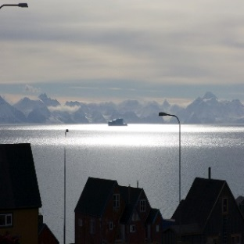
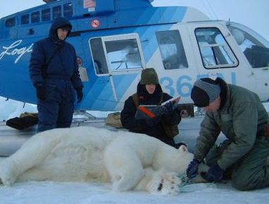
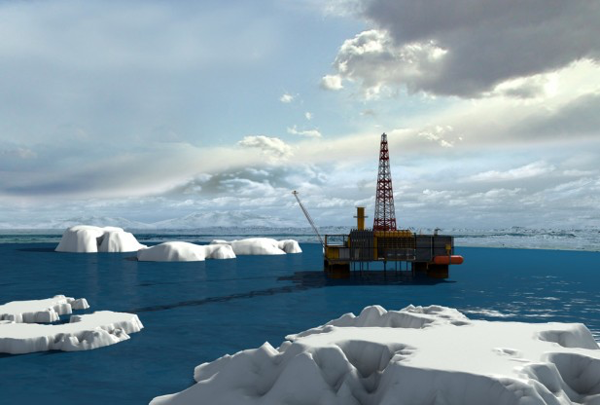
Public deliverables in the first phase:
D1.6 International Cooperation Strategy
D3.1 Survey of the existing polar research data systems and infrastructures
D2.3 Inventory of existing monitoring and modelling programmes
D3.3 Survey of existing use of space assets by European polar operators

Slide 13
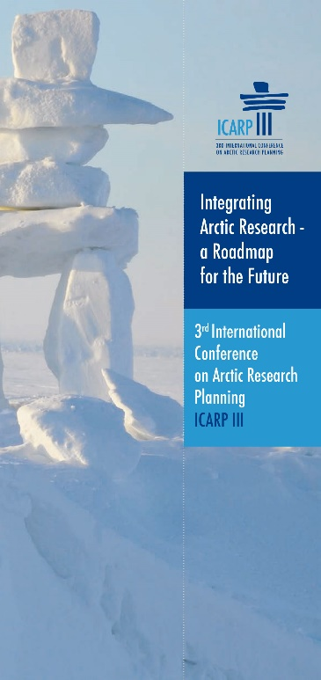



Task 2.2: Development of co-designed White Papers addressing urgent polar research questions
EU-PolarNet has just started the process to develop ca. six white papers to promote urgent polar research questions.
The white papers will be developed jointly by stakeholders and scientific experts following the „Dahlem conference methodology“
The nomination of experts by consortium partners has started in October and will be finalised by end of February

Slide 14
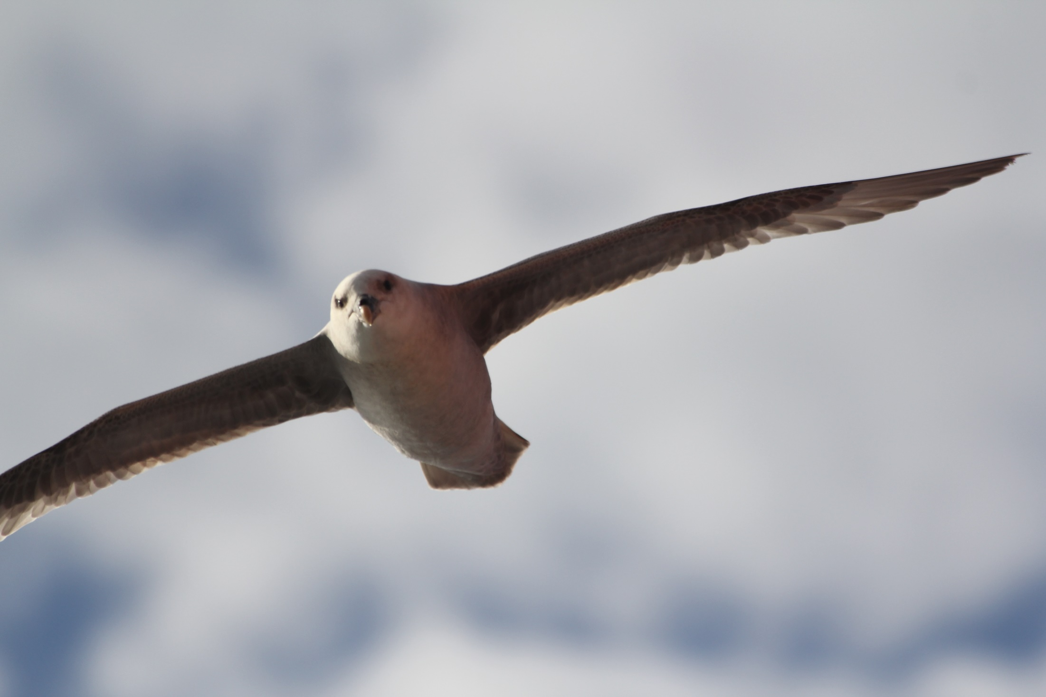
EU-PolarNet strategic work with the EC
© L. Gruebner, AWI

Slide 15
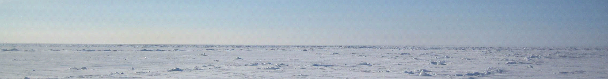


Implementing the Galway Declaration
Transatlantic Cooperation in Arctic Research
EU-PolarNet is member of the EC – Canada – US working group on “Implementation of the Transatlantic Research Alliance on North Atlantic and Arctic research”.
It supports the EC in defining and implementing research topics which could be addressed in close EC-Canadian-US cooperation. The Arctic calls in the 2016 – 17 WP of H2020 are a result of this cooperation.

Slide 16

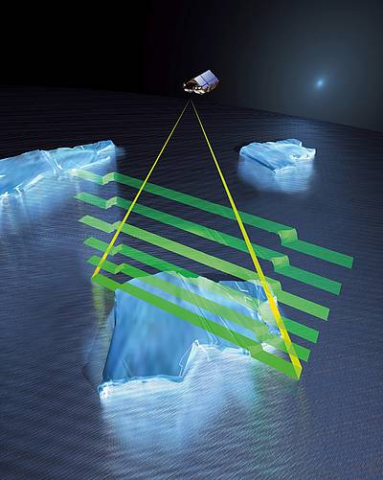
Cooperation EC and ESA
EU-PolarNet became partner in the DG RTD – ESA EOP strategic partnership Pilot activity on Arctic and participates in regular teleconferences.
Provided comments and improvements of ESA-CliC Earth Observation and Arctic Science Priorities draft
Future programming activities:
ESA Envelop 5, H2020 WP18-20 – key dates and links and preparation of a scoping paper
Support to EC/ESA in identifying Earth Observation data requirements that support Climate or in our case Polar Research
(Graphic: AOES Medialab)

Slide 17
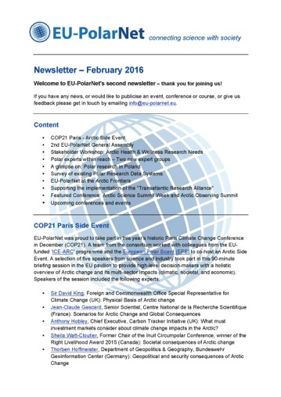
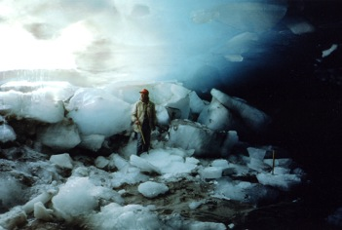
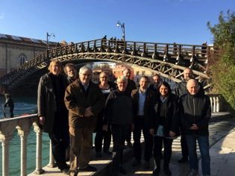
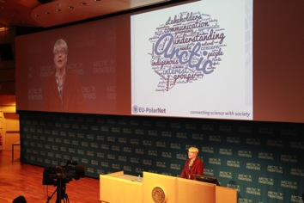
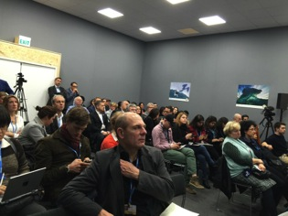
EU-PolarNet Newsletter
Issued quarterly (first edition Nov 2015)
More than 250 subscribers
News and information about:
  the consortium and affiliated projects,
  developments in European polar research,
  national polar programmes,
  past conferences and meetings,
  up-coming events.
Available via subscription (info@eu-polarnet.eu) or www.eu-polarnet.eu/news-and-events/newsletter.html

Slide 18
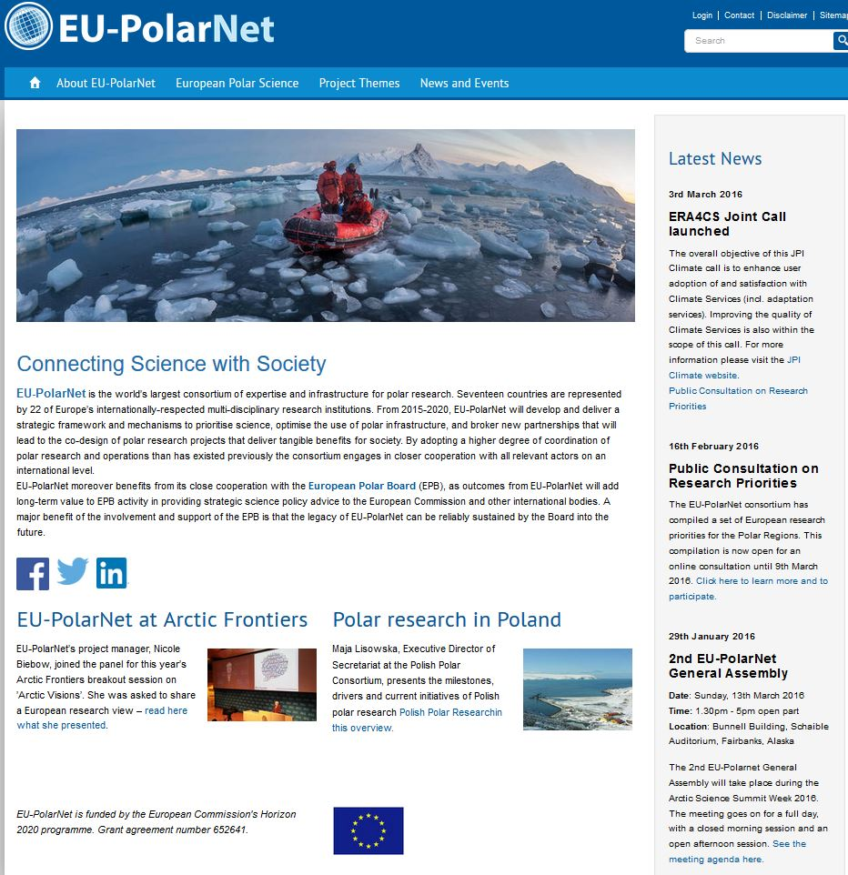
Please visit our webpage and sign up for our newsletter at info@eu-polarnet.eu

Slide 19
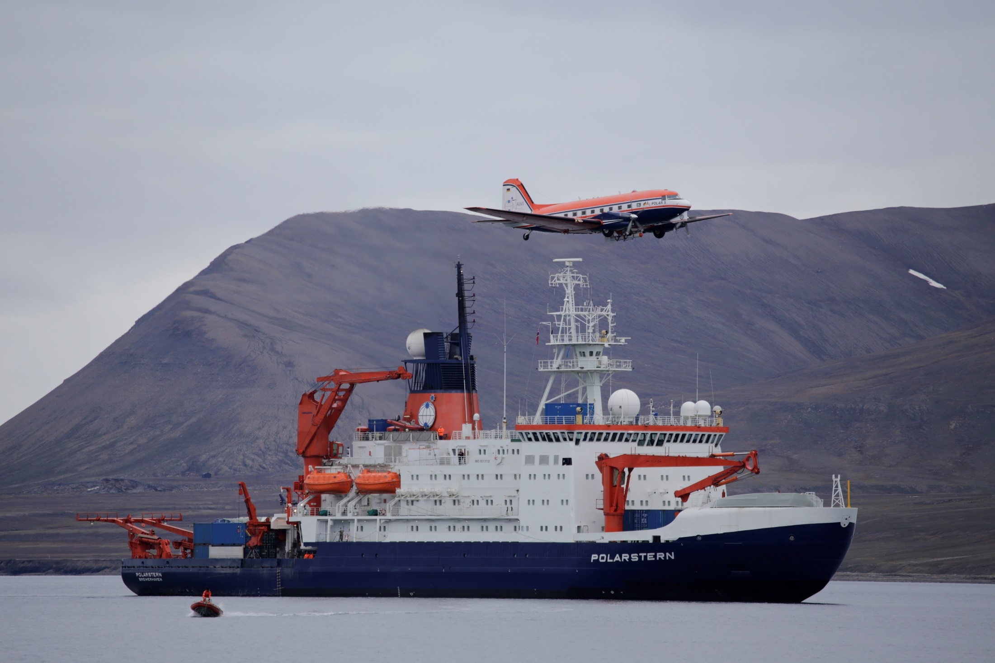
Thank you very much for your attention – Questions?
© D. Steinhage, AWI
Notes:
Approach of the project
1) Providing the background information
Consolidation of knowledge of the current European and international polar research landscape by compiling available information from ongoing research planning initiatives such as ICARP III and SCAR Horizon Scan, national research plans, EU projects
2) Strategic scoping exercise
Identify the key current research gaps and weaknesses, gaps in infrastructure capability and availability, priorities for new research programmes and infrastructure investments to address them. The exercise is carried out in close cooperation with international and transatlantic partners and stakeholders and end-users
3) Outreach to European society, research funders, public and private decision makers by publishing recommendations and providing advice on their questions relating to Polar issues.
This three phase approach will work like a virtuous circle with iterative rounds of dialogue in a series of workshops

