Slide 1
JPI Connecting Climate Knowledge for Europe (JPI Climate)
Towards collaborative practice-oriented climate research
Kick off meeting BLUE ACTION 18/19 January 2017
JPI Climate Central Secretariat
www.jpi-climate.eu
Contact: petra.manderscheid@jpi-climate.belspo.be

Slide 2
JPI Climate partners
12 Member Countries
Finnland
5 Associated Members
Norway
Estonia
Russia
ERA4CS partners
Sweden
Latvia
+ European Commission
+ Partner Institutions
(EEA, ECRA, ESA,
NordForsk)
Denmark
Lithuania
Ireland
Belarus
Great Britain
Nether- lands
Poland
Belgium
Germany
Ukraine
Luxembourg
Czech
Republic
Slovakia
Moldova
France
Switzer/ land
Austria
Hungary
Romania
Slovenia
Croatia
Bosnia/
Herze- govina
Serbia
Monte- negro
Bulgaria
Portugal
Italy
Mace-
donia
Turkey
Spain
Albania
Greece
Malta

Slide 3
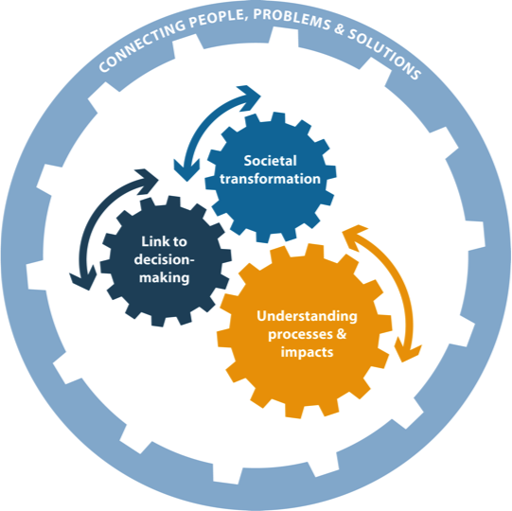
JPI Climate SRIA: 3 challenges + Strategic Mechanism
Challenge 1: Understanding the processes and consequences of climate change
Challenge 2: Improving knowledge on climate-related decision-making processes and measures
Challenge 3: Researching sustainable societal transformation in the context of climate change
Strategic Mechanism: Connecting people, problems and solutions in a systemic approach
SRIA implemented through

Slide 4
Scoping Activities and Scoping FORUM
Scoping workshops will help to inform the preparation of the first Scoping Forum:
Proposed scoping workshops 2/3 February 2017, Brussels: Climate Services - Synergies, Gaps and Challenges workshop
4-5 April 2017, Valencia: Synergy and mismatch analysis of Climate Services in the context of the ClimatEurope Festival
October 2017, Rome tbc: FORUM to develop a Joint vision for Implementation Strategy and Plan 2018-2022
Get involved to scope future implementation actions

Slide 5
ERA4CS Flagship project on climate services
2016 ERA-NET COFUND “European Research Area for Climate Services” (ERA4CS)
Joint transnational co-funded call, with 43 partners from 18 Europea countries and up to 75MEuro:
a “cash” topic, supported by 13 RFOs, on co-development for user needs and action-oriented projects Advanced co-development with users
an “in-kind” topic, supported by 30RPOs, on institutional integration of the research components of national CS
Call closed, projects now evaluated – results in February

Slide 6
About the Arctic: Joint Call 2013
Russian Arctic & Boreal Systems – 3 projects
Climate impact on the carbon emission and export from Siberian inland waters (SIWA)
- a comparative study of lake-stream networks across a climate gradient (boreal-arctic) in western Siberia with the aim to assess the role of inland waters in the carbon cycle of Siberia.
Russia, Sweden, UK - Awarded funding: 711.935 EUR
Lead Principal Investigator: Jan Karlsson, Umeå University, Sweden
Constraining uncertainties in the permafrost-climate feedback (COUP)
Aim: Better predictions of how permafrost areas will respond to a warming climate; results will contribute to improving quantifying the impact of thawing permafrost on global climate.
Denmark, Finland, Norway, Russia, Sweden, UK - Awarded funding: 1.205.183 EUR
Lead Principal Investigator: Gustaf Hugelius, Stockholm University, Sweden
More than methane: quantifying melt-driven biogas production and nutrient export from Eurasian Arctic lowland permafrost (LowPerm)
Aim: understand nutrient transport within permafrost landscapes that may lead to changes in greenhouse gas production and fertilization of the Arctic Ocean.
Denmark, Norway, Russia, UK - Awarded funding: 809.405 EUR
Lead Principal Investigator: Andrew Hodson, University of Sheffield, UK

Slide 7
For 2017: ERANET Cross-sector impact assessments + CSA internalization
ERANET Cross-sectoral and/or cross-scale climate change impact assessments; Integration of biophysical impact estimates with economic models and developing pathways to achieve the long-term objectives of the Paris Agreement (incl. Sustainable Development Goals)
CSA internationalisation: strengthening JPI Climate and climate research globally through international cooperation; understanding underlying processes of climate change, improving decision-making processes and measures and guiding in a context of sustainable development

