Slide 1

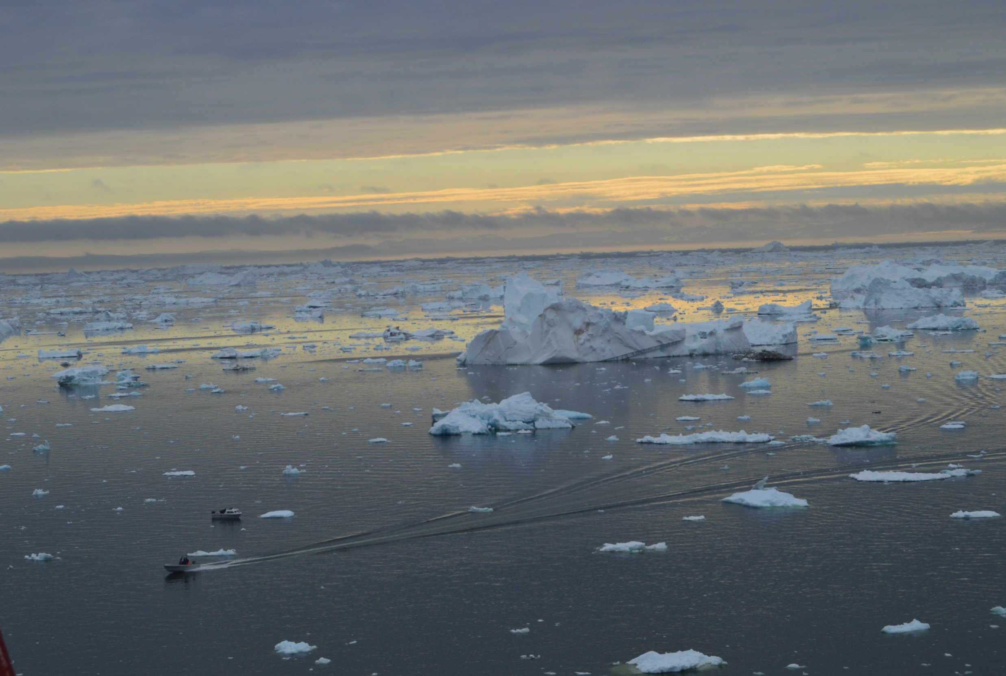
The role of Arctic sea ice in defining European extreme winters
Shuting Yang (shuting@dmi.dk)
Jens H. Christensen
(DMI)
Blue-Action kick-off meeting, Berlin, Jan. 18-20, 2015

Slide 2
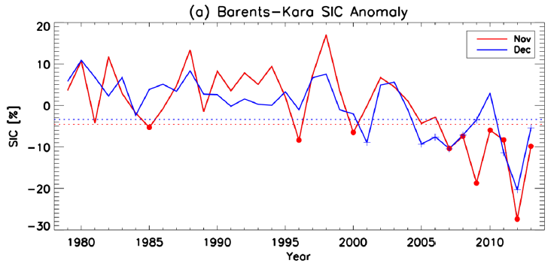
Recent Arctic sea ice trends
Trends of seasonal mean HadISST SIC 1979-2012
DJF
MAM
Temperatures in the Arctic are rising 2.5 times faster than over the rest of the world
The Arctic sea ice has been thinning, and the ice extent is declining at a rapid speed
JJA
SON
0.5 σ
Sea ice extent Oct. 2016
(Overland et al, 2016)

Slide 3
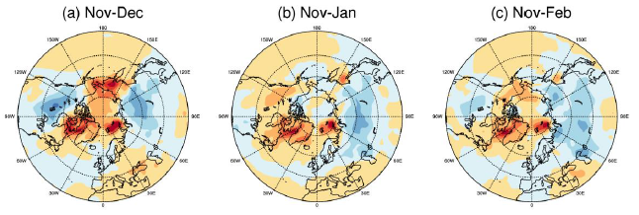
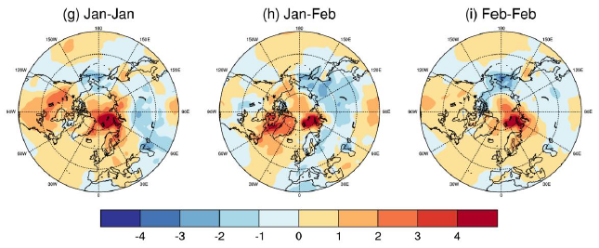
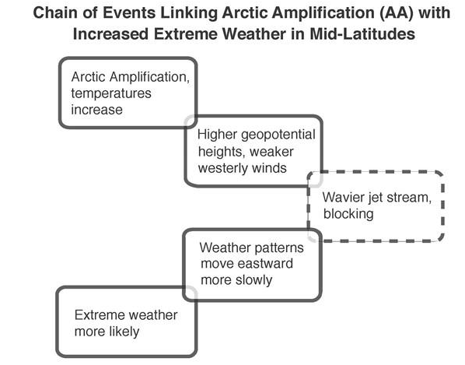
Arctic sea ice influence:
Eurasia cold surges link to Barents-Kara sea ice loss
Composite of SAT anomaly when the sea ice cover is lower
by 0.5 standard deviations than normal in the Barents-Kara Seas
Low B-K SIA
In Nov.
Dec.
Jan.
Feb.
Low B-K SIA
In Jan.
Jan.
Feb.
Overland et al, 2016: J. Clim.

Slide 4
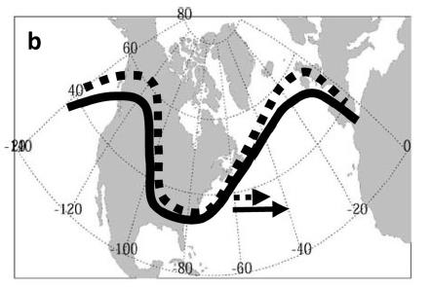
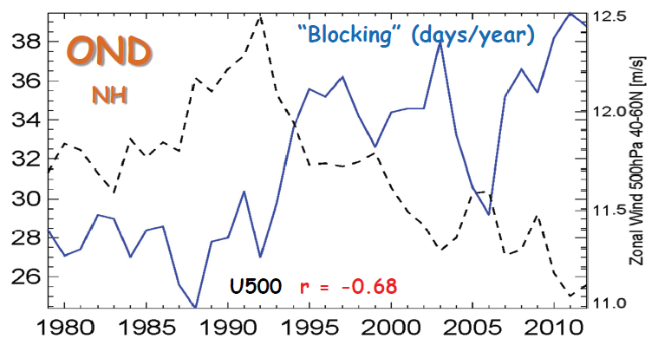
Atmospheric response to Arctic sea ice reduction: NCEP data analysis
Increased Arctic warming (less Arctic ice)
➔ Decreased N-S temperature gradient
➔ Weakened jet stream and stronger planetary waves
➔ More persistent (extreme) weather
Blocking frequency and 500 hPa u-wind
in N. America/ N. Atlantic in Autumn
Francis & Vavrus, 2012, Francis 2013

Slide 5
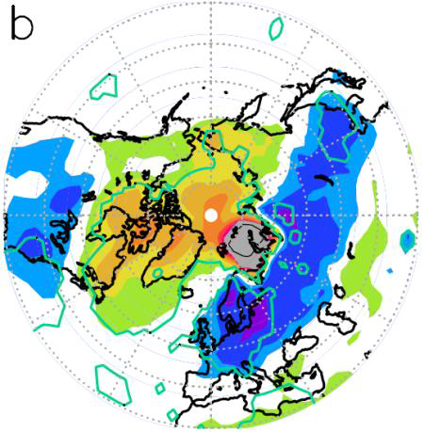
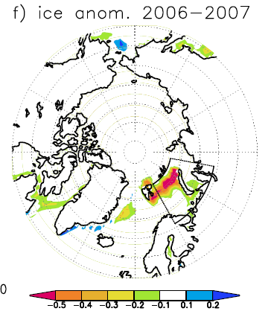
Atmospheric response to Arctic sea ice reduction: Model simulations
ECHAM5 AGCM: T42 L19
6 x 100 yr simulations
Same boundary forcing (SST/SIC) except for Barents and Kara Seas (see the sector), where the SIC In wintertime (Nov-Apr) set to
1%,20%,40%,60%,80%,100%
SSTs from year 2005-2006
ECHAM5 results: winter response difference
Surface T (40% - 80%)
850 hPa Height (40% - 80%)
1% of the NH
(Petoukhov and Semenov, 2010)
Courtesy: Semenov

Slide 6
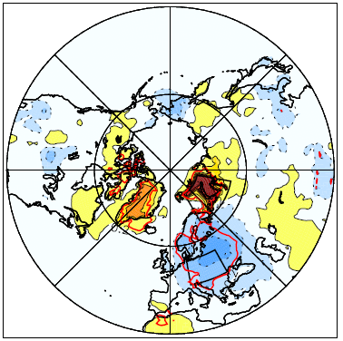
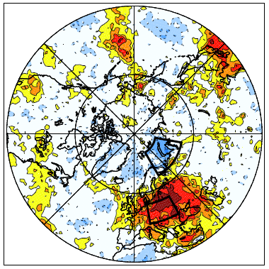


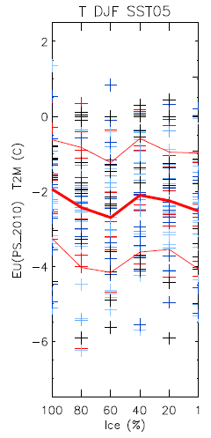
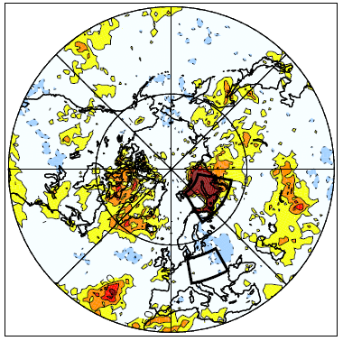
Atmospheric response to Sea Ice reduction:
– Winters are colder and more cold winters
Difference: 60% - 100%
Surface T change
changes in Prob(T<-1.5σ)
EC-Earth – AGCM (IFS)
  T159 L31
Follow the experiment setup in Petoukhov and Semenov (2010)
  6 x 100 yr simulations
  Same boundary forcing (SST/SIC) except for Barents and Kara Seas,
  where the SIC In wintertime (Nov-Apr) set to 1%,20%,40%,60%,80%,100% of the climatology
  SSTs from a cold winter year 2005-2006
➔ Cold European winter experiments
DJF T2M in central Europe
changes in Prob(T>1.5σ)
T2M (C)
Ice (%)

Slide 7
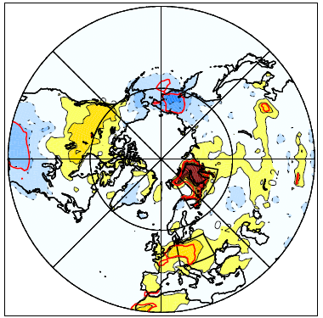
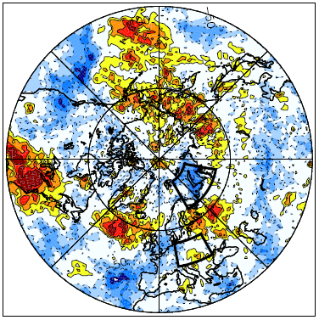


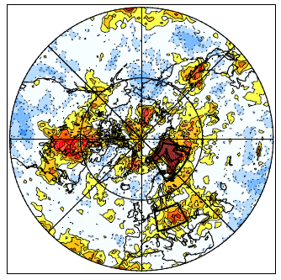
Is the atmospheric response robust?
̶ Dependence of boundary condition
Difference: 60% - 100%
Surface T change
Changes in Prob(T<-1.5σ)
EC-Earth – AGCM (IFS)
Same setup as the cold European winter experiments but
Using SSTs from a warm winter year 1989-1990
changes in Prob(T>1.5σ)

Slide 8
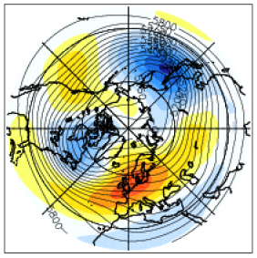
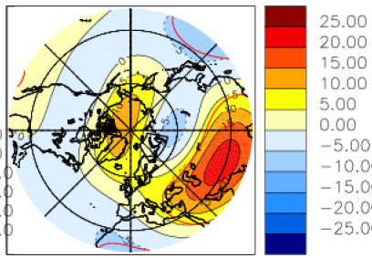
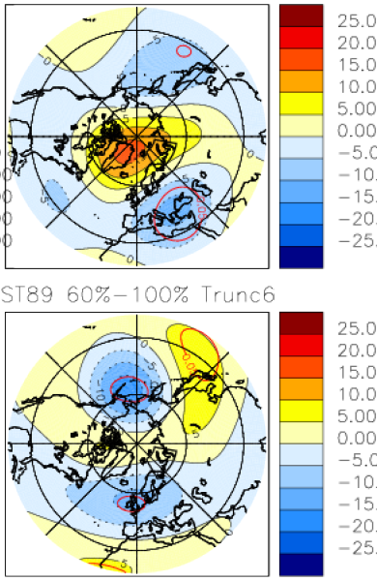
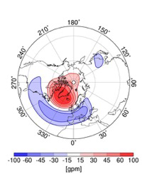
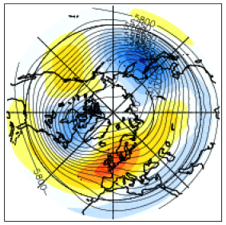
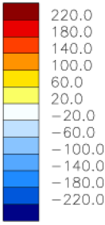
Difference in the large scale circulation pattern: Z500
“background” flow
Difference in Planetary waves (wavenumbe≤6)
Cold case
Cold - Warm
Cold case
100%
60%-100%
Warm case
Warm case
100%
60%-100%
Negative NAO pattern
(Jaiser et al, 2013)

Slide 9
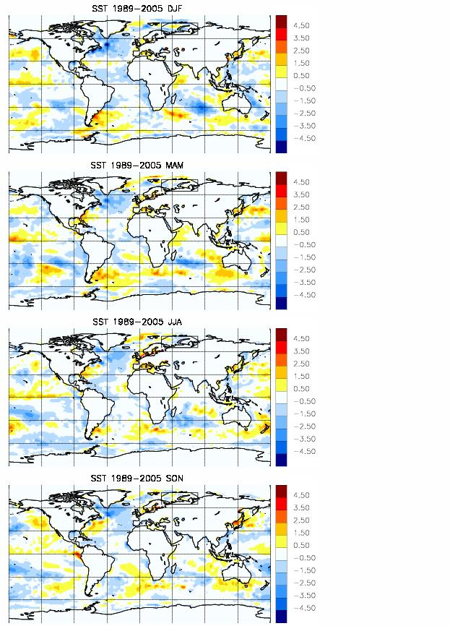
Difference in boundary conditions (SSTs):
The ‘Warm’ vs. ‘Cold’ case
SST 1989/90 – 2005/06 DJF
SST 1989/90 – 2005/06 MAM
  The monthly mean SSTs in large area of North Atlantic are more than 1°C colder in year 1989-1990 than in 2005-2006.
  => The Mixed Case: with SSTs from the ‘Cold’ case every-where but from the ‘warm’ case for N. Atlantic
SST 1989/90 – 2005/06 JJA
SST 1989/90 – 2005/06 SON

Slide 10
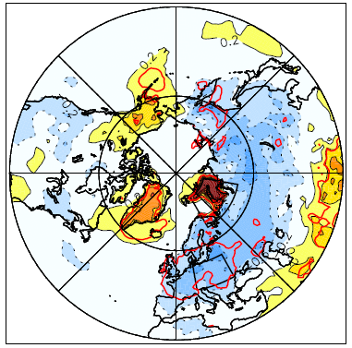
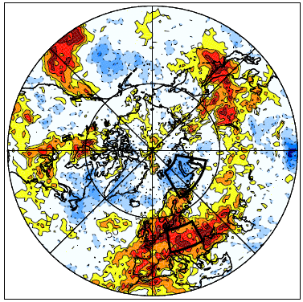
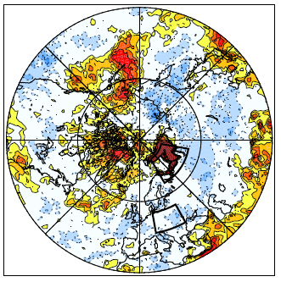
Is the atmospheric response robust?
̶ Dependence of boundary condition
Difference: 60% - 100%
Surface T change
Changes in Prob(T<-1.5σ)
EC-EARTH – atm
Same setup as the cold/Warm European winter experiments, but
forced with SSTs of the cold case everywhere except over North Atlantic where SSTs are set to be as in the warm case (the Mixed case)
Changes in Prob(T<-1.5σ)

Slide 11
Summary
Under certain conditions, the changes in sea ice in the Barents-Kara Seas have significant impacts on NH circulation, resulting in colder/more cold winters in Europe;
The atmospheric response depends on the patterns of the stationary Rossby wave that are maintained by the (global) SST condition;
The North Atlantic SSTs has little impact on the responding pattern over Eurasia;
The response is rather nonlinear.
Relevance to Blue-Action:
  Is the probability of occurrence of an extreme event linked to the phase of the circulation modes (e.g., ENSO, PDO, AMO, AO/NAO)?
  how the Arctic sea ice interplay with different phase of the circulation modes?

