Slide 1
Workpackage 3
Linkages of Arctic climate changes to lower latitudes
Leads: Yongqi Gao (NERSC) and Guillaume Gastineau (CNRS)

Slide 2
Task 3.1
Arctic warming impacts by atmospheric pathway
[Lead: NERSC; Participants: CNRS, UoS, MPI, UNIRES, DMI, CMCC, NLeSC, WHOI, IAP-NZC, IAP-RAS.]
We will focus on the atmospheric pathway which likely link extreme weather events […] over northern continents and Arctic warming.
We will in particular study
stratosphere-troposphere patways,
troposphere dynamics: the jet stream and atmospheric planetary-waves.
the linkages evolve […] due to the change of AMO and IPO.

Slide 3
Coordinated experiments
atmosphere-only model experiments […], with large ensemble to estimate a relative role of internal atmospheric variability and boundary forcing.
In contrast to AMIP-type experiments, we will use high-resolution boundary forcing (daily, ~0.25º)
Model | NorESM | IPSL-CM | EC-Earth | CMCC-CM | ECHAM5 | IAP-AGCM | HadGEM | ICON | EC-Earth
Horizontal resolution | 100km | 100km | 100km | 100km | 100 km | 100km | 40km | 40km | 40km
Partner | NERSC | CNRS-LOCEAN | DMI | CMCC | IAP-RAS | IAP-NZC | UoS | MPI-M | NLeSC

Slide 4
Experimental protocol
A-Exp1 : SST and SIC vary 1979-present.
Plan A : Reproduce experimental protocol of HighResMip (Haarsma et al., 2016, GMD) with SST and SIC from HadISST2.2. Minimum 5 (high resolution) or 20 (std resolution).
-> check if SIC has issues, and consistency with SST.
Plan B : process the data and correct inconsitencies
A-Exp2 : a lot of debate…
Plan A : daily SIC of an early year (1984?) and vary SST.
Arctic warming impact = A-Exp1 – A-Exp2
Plan B : daily SIC climatology and SST vary. Then:
-> prb as it may smooth the sea-ice edge
Plan C : SIC vary and climatological SST -> prb as it may lead to low signal.
Other concerns : sea-ice thickness important, remove the largest inconsistency between SIC and SST.

Slide 5
Experimental protocol
A-Exp1 : SST and SIC vary 1979-present
Plan A : Reproduce experimental protocol of HighResMip (Haarsma et al., 2016, GMD) with SST and SIC from HadISST2.2.
-> check if SIC has issues, and consistency with SST.
Plan B : process the data and correct inconsitencies
A-Exp2 : a lot of debate…
Plan A : daily SIC climatology and SST vary. Then:
Arctic warming impact = A-Exp1 – A-Exp2 -> prb as it may smooth the sea-ice edge
Plan B : daily SIC of an early year (1984?) and vary SST.
Plan C : SIC vary and climatological SST -> prb as it may lead to low signal.
Other concerns : sea-ice thickness important, remove the largest inconsistency between SIC and SST.

Slide 6
Description of work:
Two other coordinated experiments will focus on the modulation of the impacts of a warming Arctic by the transition of both AMO and IPO. For this, daily SST in the North Atlantic or in the Pacific Ocean will be fixed to a daily climatology, while the rest of the protocol is identical to A-Exp2 (A-Exp3 and A-Exp4 respectively).
A-Exp3 and A-Exp4: few discussions
Plan A : SST climatology in N. Atl. or Pacific Ocean, as A-Exp2 elsewhere.
Plan B: experiment pacemaker-like (DCPP protocol described in Boer et al., 2016)

Slide 7
Deadline:
D3.1 Identification of the surface state influence in representing the Arctic warming […]
Lead by NERSC -> Yongqi Gao. Due date: Mth 24.
D3.2 Identification of key processes in bridging the Arctic warming impact […]
Lead by MPI -> D. Matei. Due date: Mth 24.
Method:
Circulate a document bewteen the groups to specify the experimental protocol. – in a few days.
Send it and discuss it with a selected groups from APPLICATE, PRIMAVERA and US-partners.
Fix the experimental protocol in the coming month.
Notes:
No milestones in fact. Continue to work to mth 48.

Slide 8
Task 3.2 : Arctic warming impacts : role of air-sea coupling
CNRS, NERSC, MPI

Slide 9
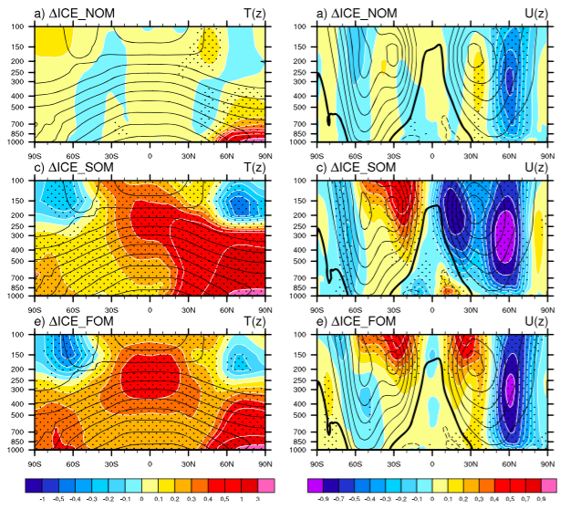
Coupled simulation at equilibrium where Arctic sea ice reduction is imposed
AGCM
Slab coupled to AGCM
Full AOGCM
Deser et al. 2016, GRL

Slide 10
Outstanding question:
Where do the coupled feedback occur? What are the relative importance of the Altantic and Pacific?
What is the robustness of the coupled processes given the model uncertainties?
What are the time adjustement and time scale for these feedbacks? Intra-seasonal? Decades?
Description of work for Task 3.2 :
The amplification/damping effect of active air-sea coupling in establishing the Arctic warming impact on the […] northern continents will be investigated using […] coordinated coupled model experiments. To represent the observed Arctic warming, we will restore the surface heat flux/sea surface temperature in the Arctic Ocean to the observations (AO-Exp1).
The coordinated experiments will enable us to investigate the role of ocean-atmosphere coupling in amplifying or damping the Arctic warming impact [..] and in affecting the ocean circulation […].

Slide 11
Methods : AO-Exp1
Models/groups participating : NorESM, IPSL-CM6, MPI-ESM
Include a heating term in Arctic to melt to restore the sea-ice toward the observation :
- Prescribe a single pattern of Arctic warming based on obserations – from 2000-2015 for example
Method :
Plan A : LW modification
Plan B : SST restoring as in Kug et al. (2015), relax time scale of 1 day, or SIC nudging.
Ensemble size: 20 or more

Slide 12
Description of work:
Additional experiments will distinguish between the role of the […] Atlantic and Pacific oceans by prescribing an AMO phase in the Atlantic (AO-Exp2) or an IPO phase in the Pacific (AO-Exp3) […].
Methods : AO-Exp2 and AO-Exp3
Models/groups participating : NorESM, IPSL-CM6, MPI-ESM
Same as AO-Exp1, but Atlantic and Pacific state imposed.

Slide 13
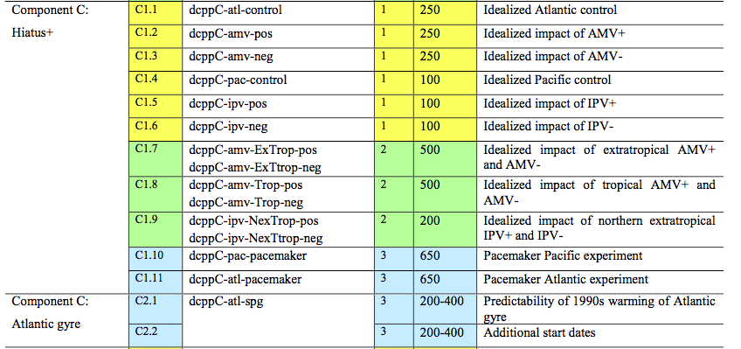
DCPP experiments
Boer et al. 2016, Geosci. Model Dev.

Slide 14
Plan A :
Use a single ‘’warm Arctic’’ pattern.
Freeze SST in the Atl. or Pac. while Arctic warm (Atl. / Pac. Controls)
Using the idealized IPO and AMO pattern :
- AMO+ and AMO- including Arctic warming.
- IPO+ and IPO- including Arctic warming.
-> nice to study the AMO and IPO atmospheric impacts… But more idealized.

Slide 15
Plan B:
Using Pacemaker experiment methodology.
Prescribed SST/SIC monthly/daily variab.
- Atlantic Pacemaker
- Pacific Pacemaker
-> nice for intra-seasonal variability and comparison with obs., but small signal.

Slide 16
Deliverable
Deliverable D3.3
Role of ocean- atmosphere coupling in bridging the Arctic warming over lower latitudes
Lead: Guillaume gastineau, CNRS
Due date : Mth 36

Slide 17
Task 3.3: Impact of Arctic Ocean freshening on the Northern Hemisphere climate
Didier Swingedouw, Christophe Herbaut, Juliette Mignot, Marie-Noelle Houssais

Slide 18
An impact of freshwater release in the North Atlantic?
Rahmstorf et al. 2015
Rahmstorf et al. (2015): Greenland ice sheet (GrIS) melting as a key player for 20th AMOC weakening (if any…)
Böning et al. (2016): impact of GrIS melting only clear since 2010s in the Labrador Sea convective activity
What is the exact impact of GrIS melting over instrumental era?

Slide 19
Objectives of Task 3.3
Establish the impact of last few decades freshwater release in the Arctic-North Atlantic sector on:
the ocean stratification
the ocean dynamics
Estimate the sensitivity to the different fresh water sources: river runoff, Greenland ice sheet melting (not included in CMIP5 models), precipitations…
Evaluate the transport pathway of the freshwater release
Evaluate the impact of the coupling with atmosphere and ocean model resolution on the ocean response
Attribute the recent ocean variability in the North Atlantic

Slide 20
What we propose to do
Attribution of AMOC changes: historical simulations and coupled reanalysis from AOGCM IPSL-CM6A-LR including GrIS melting (1900-2016)
Use of 1/24°regional ocean-only model to estimate robustness of the AOGCM results
Which GrIS melting scenario? I think we want to go as realistic as possible? Box & Colgan (2013), Bamber et al. (2013), Fettweis et al. (2016 agreement to provide monthly mean data of GrIS melting runoff), DMI?
Analyse the pathway of GrIS melting and Arctic runoff through release of tracers (passive, Lagrangian)
This could be key concerning the impact of freshwater on ocean dynamics (Swingedouw et al. 2013)
Analyse role on Arctic stratification, and then freshwater transport from the Arctic to the North Atlantic

Slide 21
Task 3.4 Improve the representation of surface heat flux in the Arctic Presenter: Richard Davy, NERSC
Richard Davy

Slide 22
Plan of Work
Task 3.4 Improve representation of surface heat flux in Arctic [Lead: NERSC; Participant: CNRS, MPIM, IAP-NZC Month 1-24. Deliverables associated: D3.5]
We will use results from existing turbulence-resolving simulations over cracks to establish an empirical relationship between the crack-sizes and the net heat flux from a region. Estimates of the crack-size distribution are available from high-resolution SPOT satellite observations of the sea-ice cover, which were used for earlier attempts to quantify the fluxes from cracks. Then by combining the empirical relationship with the observed distribution of crack-sizes, we can parameterise the surface fluxes as a function of the open water fraction. This will allow us to establish the link between sea-ice concentration and anomalous heat flux equivalent to those found from observed SIC maxima [NERSC] (D3.5). This new parameterization will be tested using ensemble simulations with atmosphere components of NorESM IPSL-CM, MPIM-ESM (to repeat A-Exp1), to assess the effect of the changed surface heat flux taking into account the crack-sizes and fundamental thermodynamics and dynamics of the Arctic. If the benefits are clear, the corresponding modelling centres may adopt the new parameterisations scheme as part of their standard systems. [NERSC, CNRS, MPI, IAP-NZC] (D3.5)

Slide 23
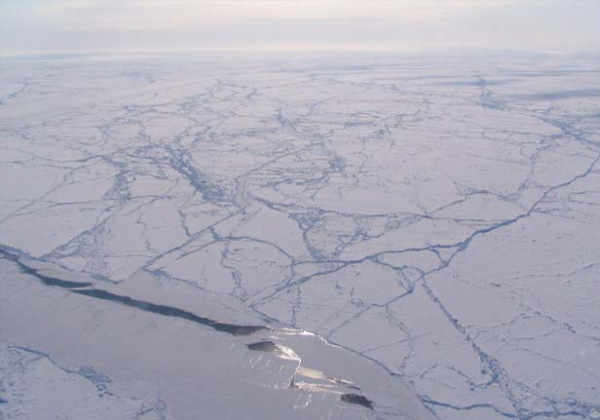
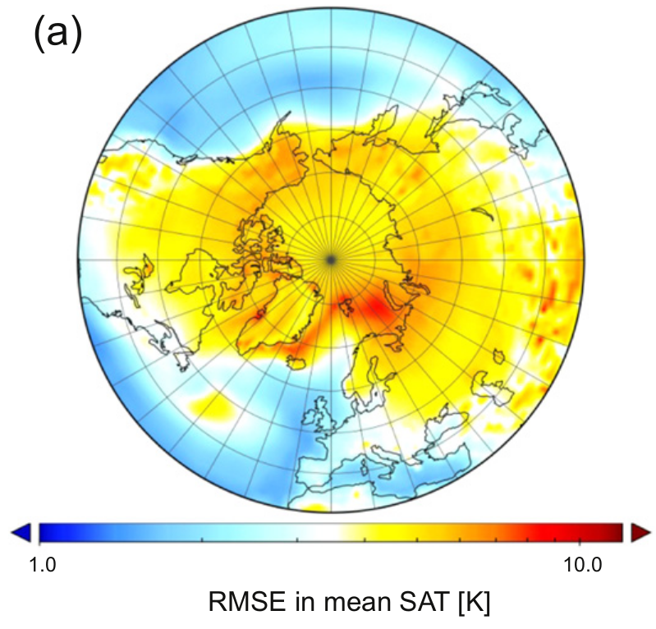
Background
Leads: Openings in the sea-ice forming either dynamically or thermodynamically
Sensible heat flux from leads can be ~300 W m⁻²
Annual average over Arctic ~ 3 W m⁻²

Slide 24
Plan of Work
Develop and implement new parameterization within NorESM
Models: NorESM, IPSL-CM, MPIM-ESM
Ensemble of simulations using A-exp1 setup for Boundary Conditions
Assessment of local climate using ERA-Interim, ASR

Slide 25
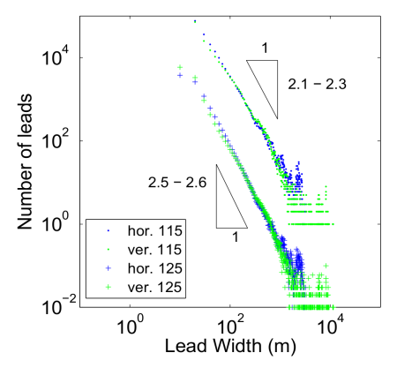
Synthesis of new scheme
Effective lead width description
NorESM Coupler

Slide 26
Anticipated impacts
Increased surface sensible heat flux
Surface warming (sensitivities of ~4K / 1% SIC)
Reduced PBL stability
- Reduces sensitivity of T to further forcing

Slide 27
D3.4. Oceanic and climatic impacts of freshwater release over the last few decades
Lead : CNRS Due date: Mth 36 -> Didier Swingedouw
D3.5 Improved key process in representing Arctic warming
Lead : NERSC. Due date : Mth 24 -> Yongqi Gao

Slide 28
WP3 Milestones
MS1
Completed simulations by atmosphere-only models (Month 18)
Related work package(s): WP3 and WP2
Means of verification: Simulated data available
Who is in charge of attaining this milestone (acronym of the partner): NERSC
MS2
Completed simulations by coupled climate models (Month 24)
Related work package(s): WP3
Means of verification: Simulated data available
Who is in charge of attaining this milestone (acronym of the partner): CNRS-LOCEAN
MS3
Oceanic and climatic impacts of freshwater release (Month 36)
Quantification of fresh water budget and pathway
Related work package(s): WP3
Means of verification: Delivery of D3.4
Who is in charge of attaining this milestone (acronym of the partner): CNRS-EPOC

